Slide 1
Surface HUB
Design, Develop, Deploy Large Shared Screen Interactive Experiences
Dr. Neil Roodyn
Notes:
On this slide we just briefly mention about the topic and as we open the next slide, start introducing ourselves.
Cortana – highlight it is not there ? Not so much ☺ -RS1 removal
Hello – Passport – not a personal device
Skype – integration limited
NFC – not reliable in experiements
Accessability
Continium – works better together

Slide 2
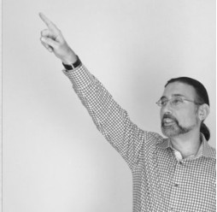

Presenter Intro
Dr. Neil Roodyn
A founder, entrepreneur, consultant, trainer and author
Sankar Nemani
Principal Program Manager
WDG PAX Team
Notes:
Introduce ourselves

Slide 3
Welcome!
Introduction
Design Overview
Tutorials
Notes:
Sankar to ask: Today we are doing this presentation, but this is part of a larger series right?
Dr. Neil to talk through the slide

Slide 4
What is Surface HUB?
Notes:
What is the product is, and is not

Slide 5
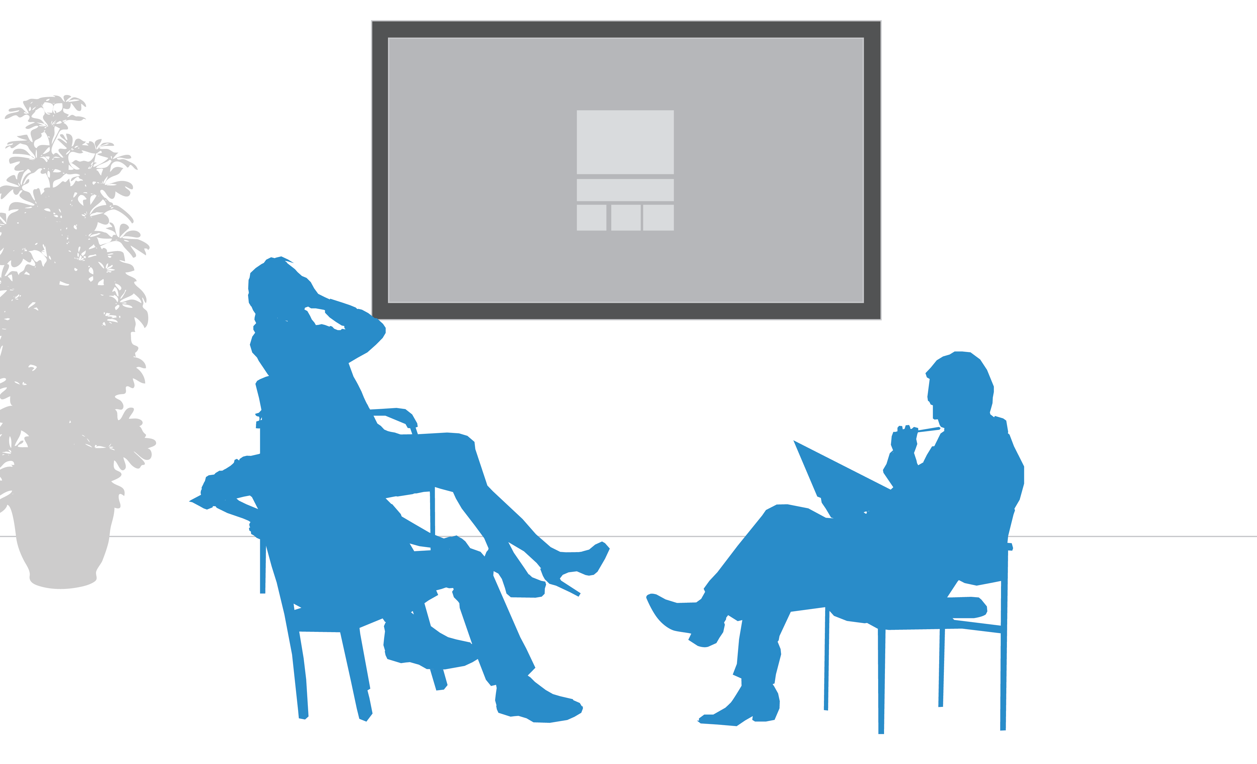
Large shared screen Windows 10 device
Notes:
Q from Neil: So Sankar, what is Surface Hub?
Sankar:
Windows 10
More than one person
Multi-user

Slide 6
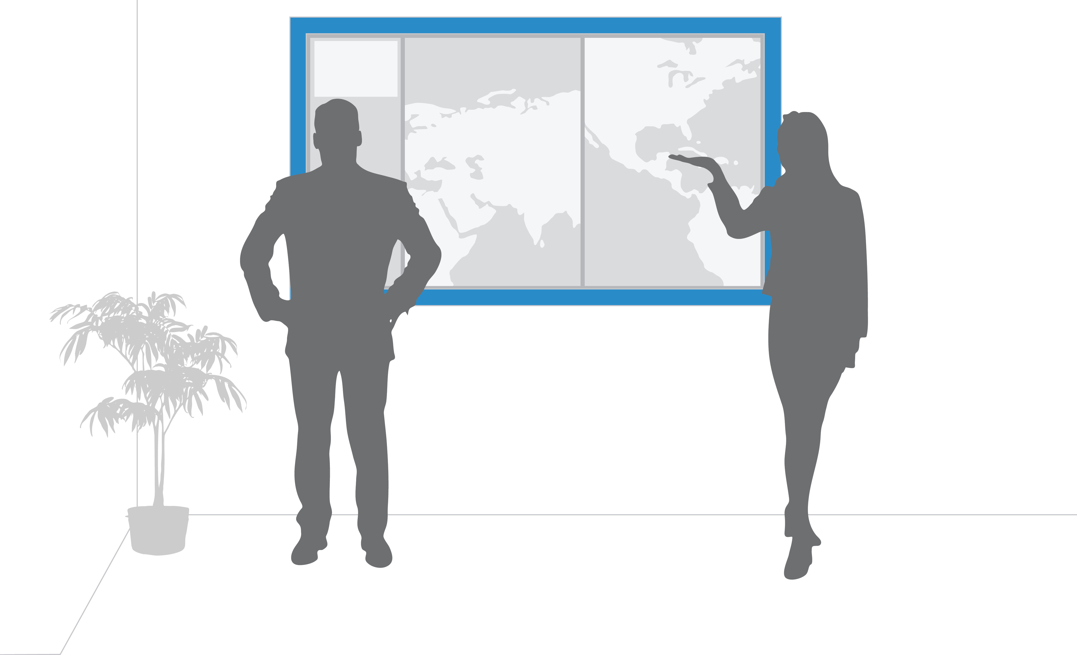
Typically in a fixed location mounted to a wall
Notes:
Dr. Neil to talk about the fixed location
Sankar jumps in – other options (move from one room to another, rolling stands)

Slide 7

Internet connected
Notes:
Sankar to ask about: Is there anything we should know on how it is connected to the network and the Internet?
Dr. Neil to explain the details and go into the next slide
Internet, access resources to Cloud, access to Office365 but not a person user account;
Not only web based; can build rich application
Sankar – why it’s not a person user account what personal user account is for

Slide 8

Office 365 Enabled
Notes:
Dr. Neil talks about this slide
Office 365 connected instead of “exchange connected” – Office 365 Enabled
When you book meeting, hub pop up, access to the AD and calendar, sharepoint, Onedrive for business, cloud data, it does have an AD account

Slide 9
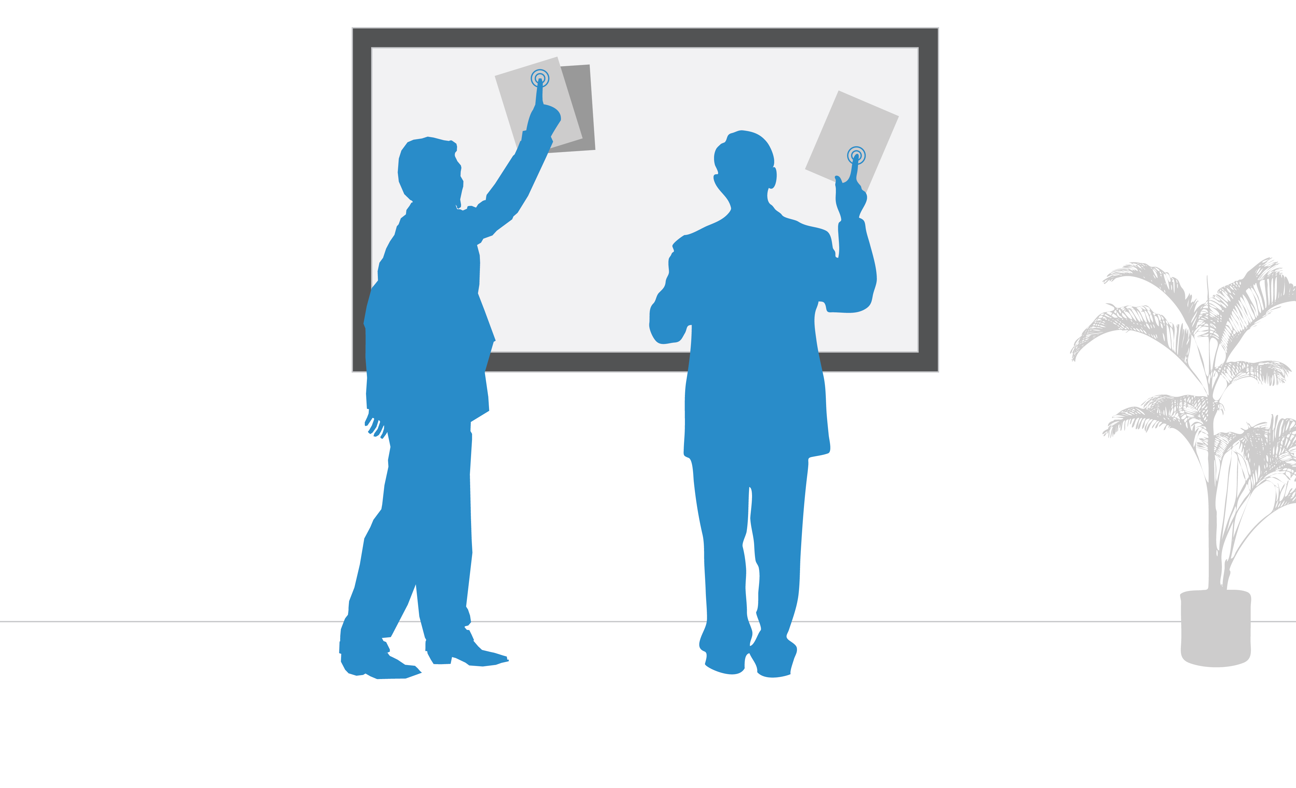
Multi-user and multi-touch
Notes:
UI aspect – multi-user and multi-touch
Enable more than 1 person to interact with the device
Dr. Neil and Sankar to demonstrate using touch at the same time.
Sankar to mention that Dr. Neil will be covering more in the design session

Slide 10
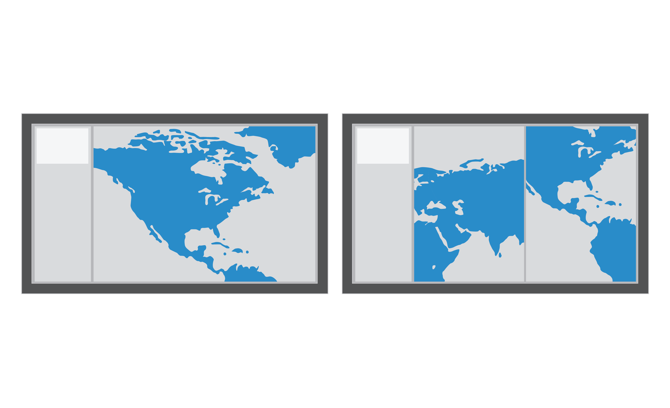
Full screen or half screen
Notes:
Apps will run full screen or half screen
Dr. Neil brings up an app to demo the full screen and half screen, see the app goes to different mode
Sankar: Clarify that it’s different from the Windows 10 Desktop where multiple windows are active at the same time

Slide 11
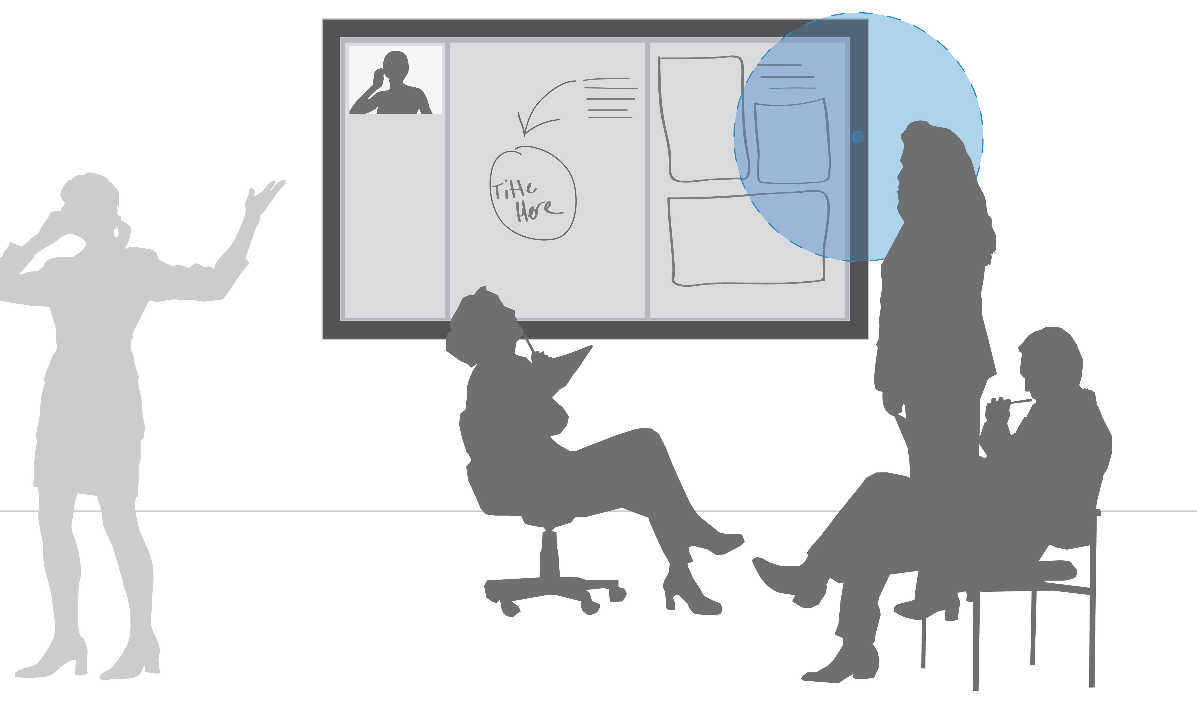
Two cameras
Notes:
Sankar to ask if the apps can get the feed from both the cameras and know what is coming from which camera.

Slide 12
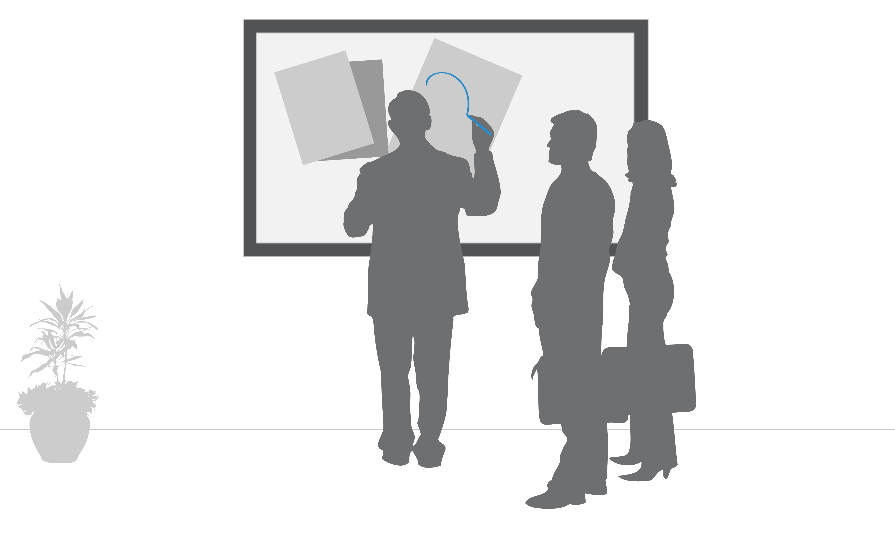
Pen Enabled
Notes:
Dr. Neil to describe the usage of pens
Demo – use the two pens and draw at the same time
Sankar question – Can the pen and finger be used simultaneously? Do the app developers know what type of event it is?

Slide 13
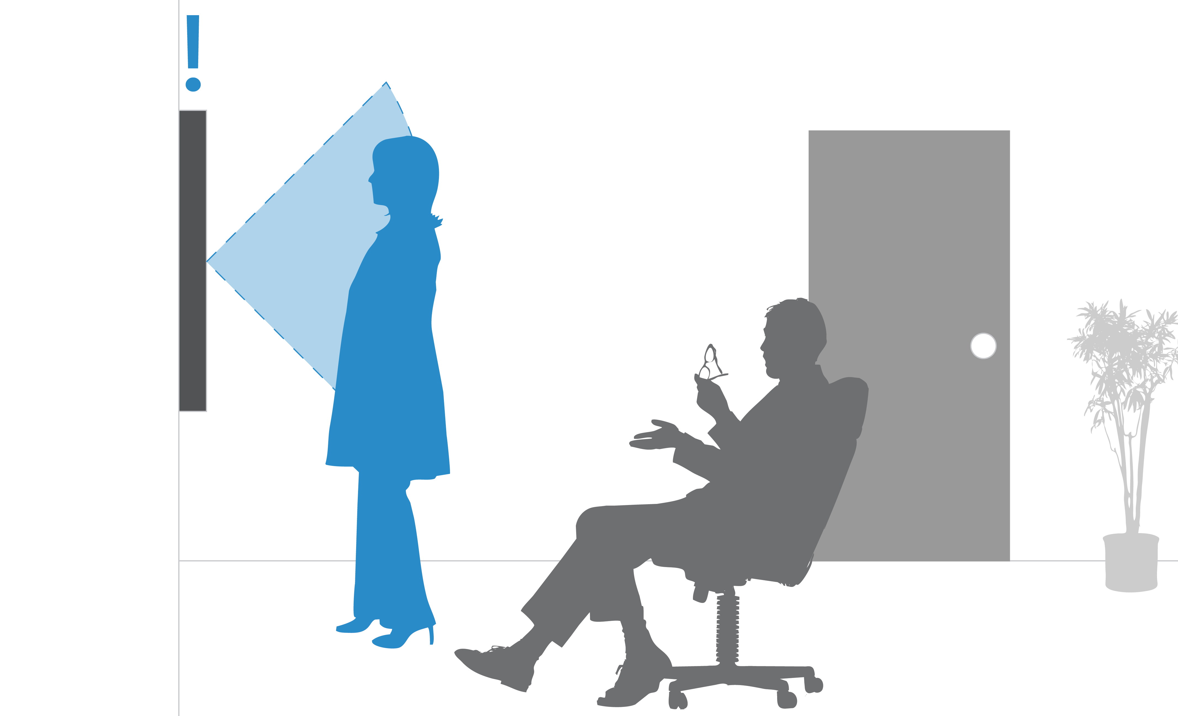
Proximity Sensor
Notes:
When you walk in the room, it knows when people are around
Not much dev needs to do
Sankar ask question: can it automatically start up the app; Lead to the NFC

Slide 14
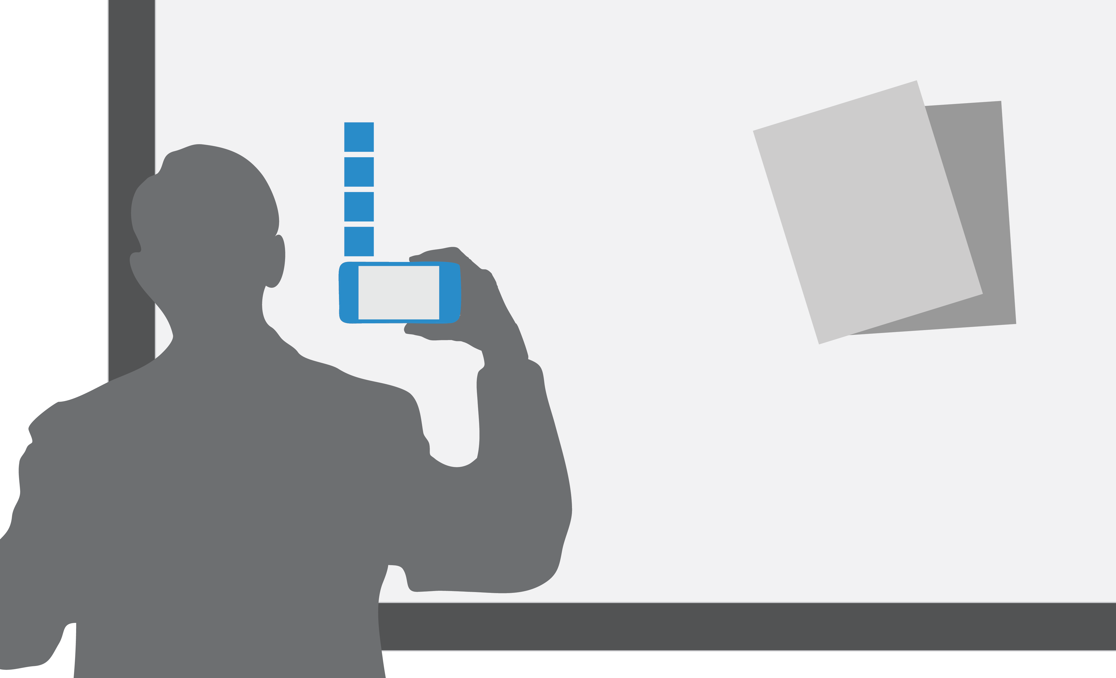
NFC reader
Notes:
Dr. Neil: Can be used to start up an app
Sankar: In the special scenarios where authentication is needed, developers can use this to provide a second factor authentication and things like that

Slide 15
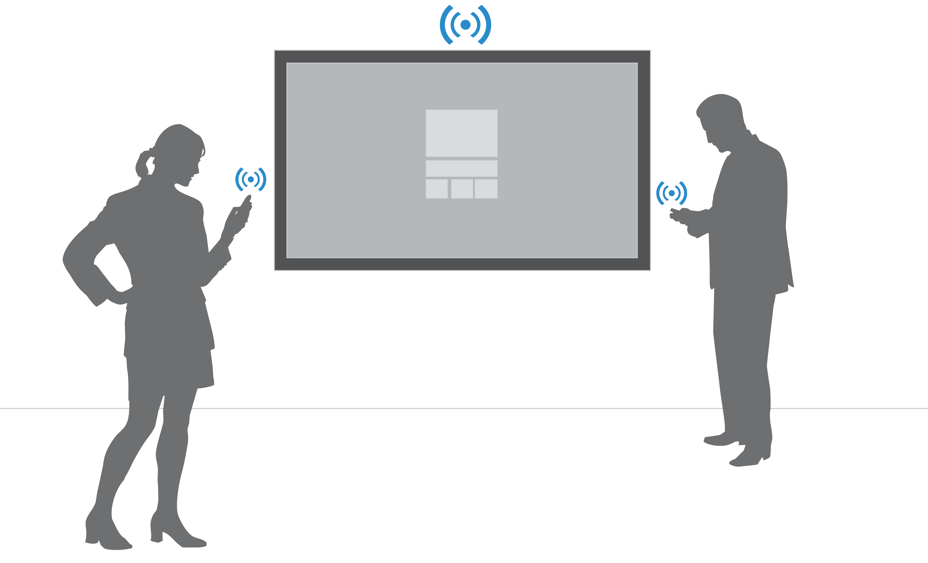
Bluetooth
Notes:
Bluetooth – within range or send the signal to trigger behavior
Review scenarios and considerations between WIFI vs Bluetooth

Slide 16
What Surface HUB is NOT!
Notes:
Sankar will lead and Neil asks questions

Slide 17
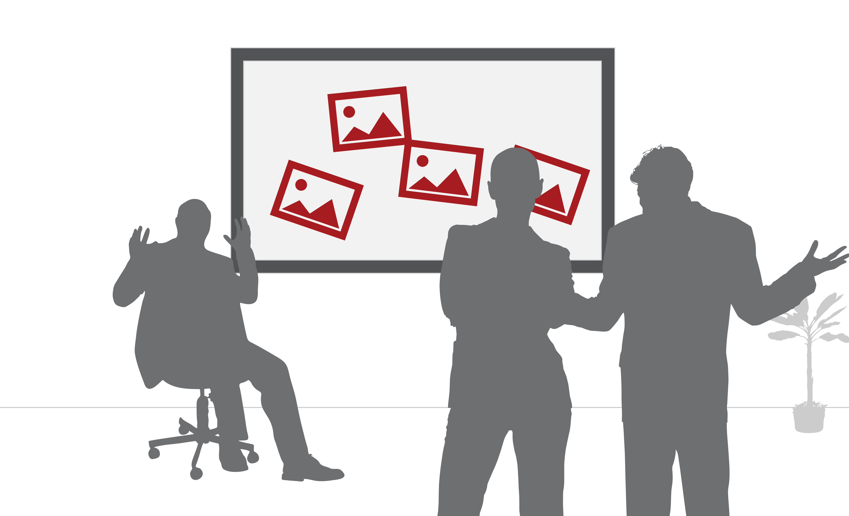
Personal Computer
Notes:
Sankar: It shouldn’t be seen as a personal computer. The usual aspects that we expect from a personal computer don’t exist with Surface Hub

Slide 18
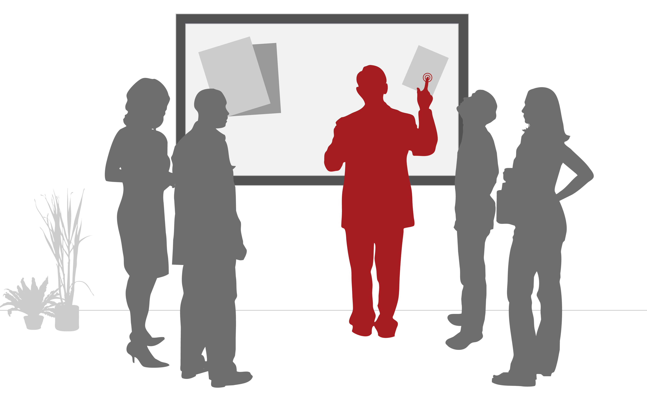
Single User
Notes:
For example, it is not bound to a single user. It is designed for sharing and collaboration. We will talk more about what it means to app developers later

Slide 19
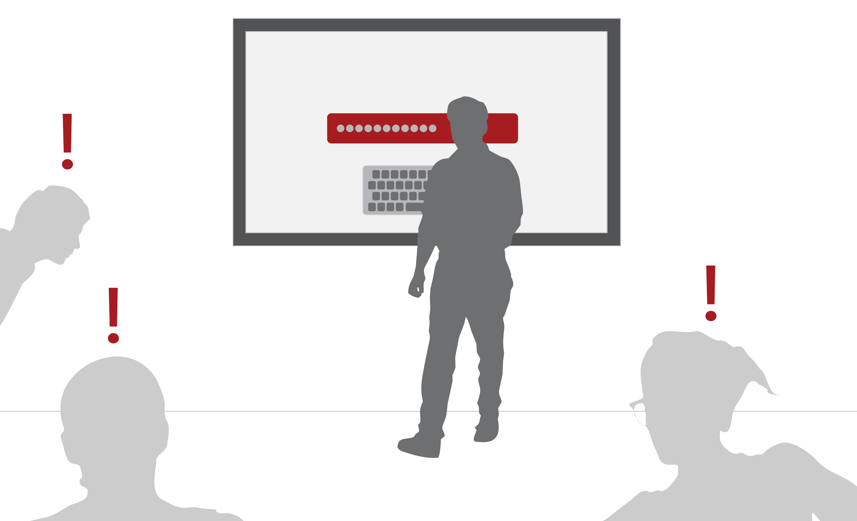
Something you log into
Notes:
Surface hub is not something you log into. It just turns on when you walk to it, and you and your team just start interacting with it,

Slide 20
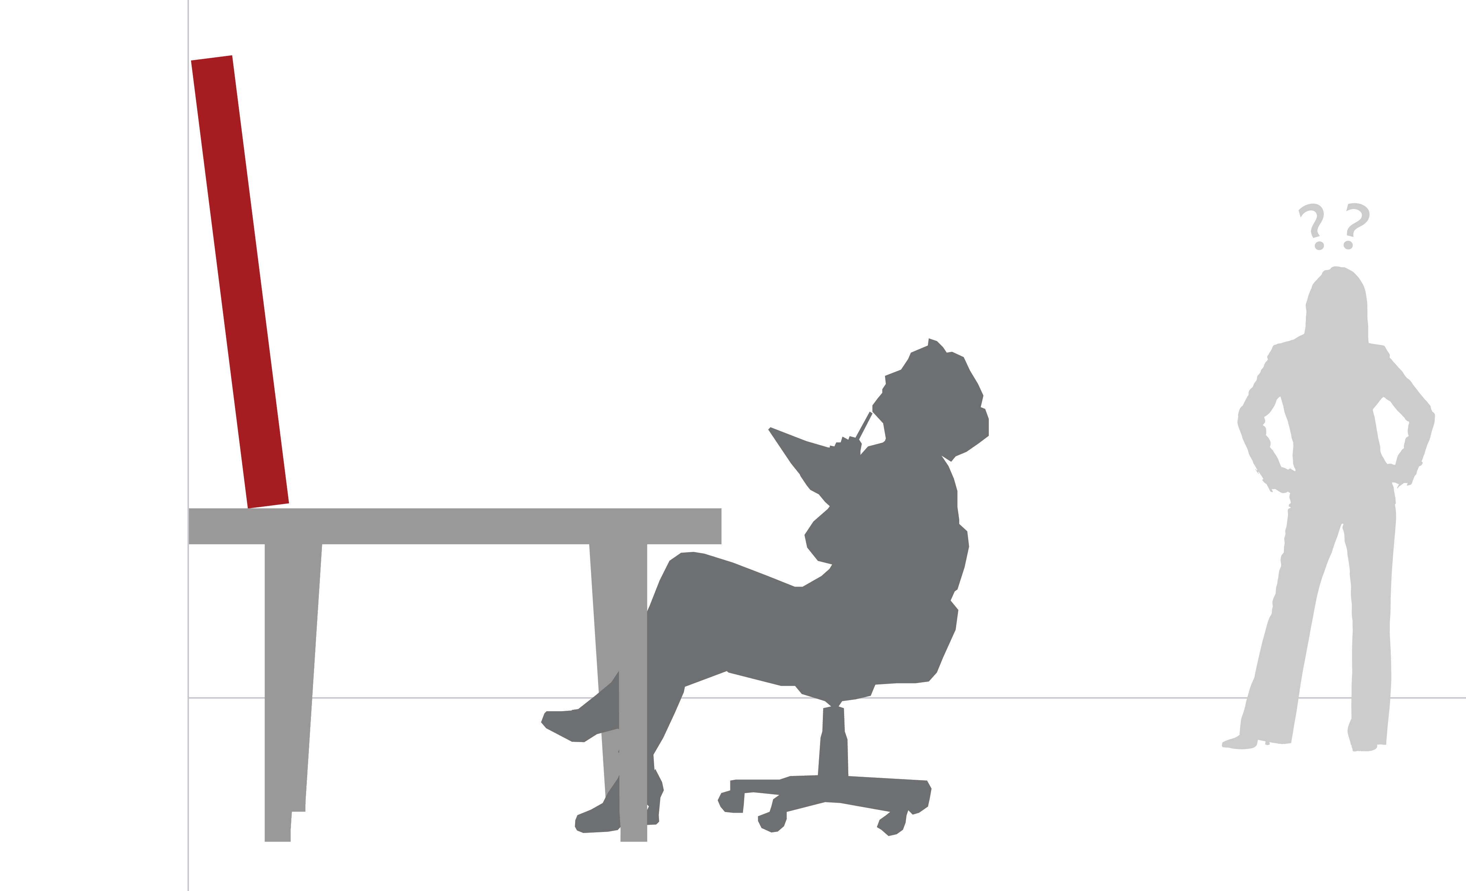
Desktop
Notes:
Not use this as a huge personal desktop device;
Usually purchased for TEAM and utilized by TEAM rather than in a private office

Slide 21
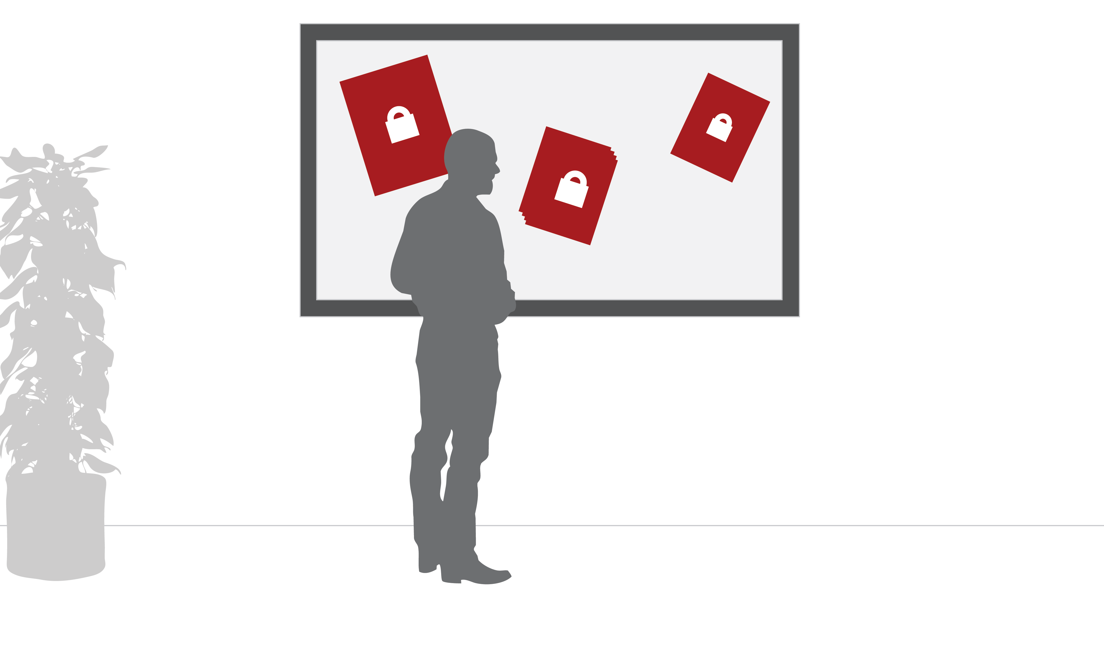
A place to store your files and data
Notes:
Sankar to talk about: Last but not the least, since it is a shared space device, after each session, the hub erases all the application state and resets. This is different from factory reset of course.
Dr. Neil to jump in and talk about the data saving options w.r.t onederive, on the network, sharepoint etc.

Slide 22
Surface HUB Scenarios
Notes:
Sankar to lead this:
Now that we have talked about what this device is and is not. Let us look into some of the scenarios that developers can build apps for.

Slide 23
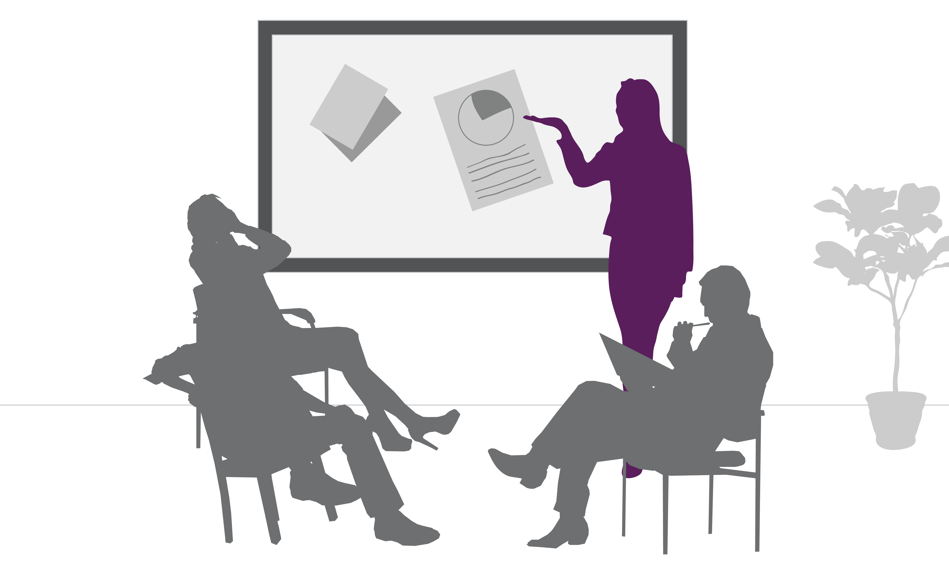
Presentations
Notes:
Presentations. We can have multiple people presenting at the same time in a very interactive way.
Dr. Neil to mention that the way Sankar and he are doing right now.

Slide 24
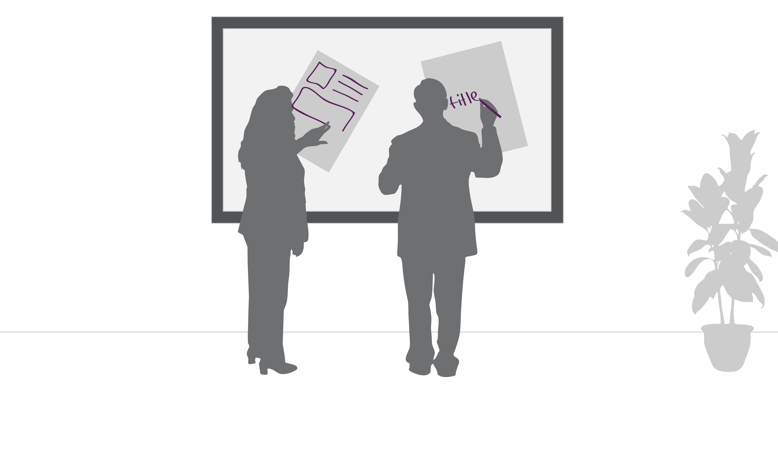
Brainstorming
Notes:
In a brainstorming scenario, collaborating and working on different ideas together
Like Dr. Neil writes Hub is Cool. Sankar writes and awesome

Slide 25
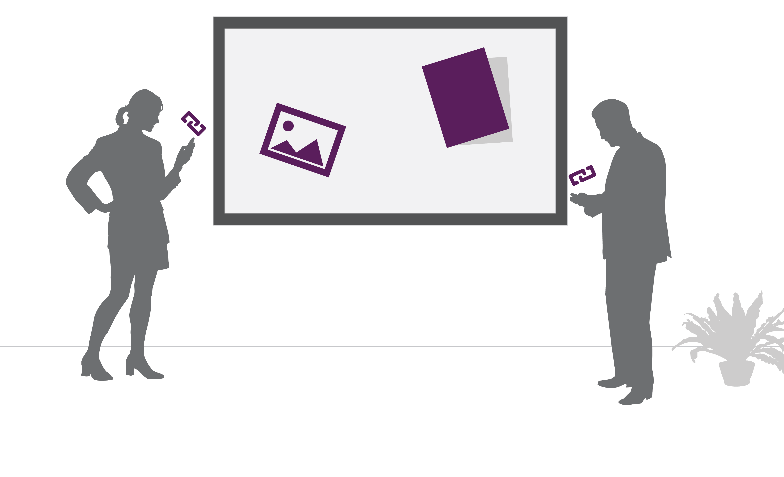
Sharing
Notes:
Another scenario is where content can be brought from multiple resources to the session, from their network sources, devices etc. And once they are put together sharing it back. For example, building collages, sprint meetings etc.
Dr. Neil asks: can app highlight all of these?
Sankar: Of course and these are just a few of the scenarios possible. As usual many more creative scenarios will unfold when developers start to use this platform as their creative canvas.

Slide 26
Why your customer cares about Surface HUB?
Notes:
Sankar ask question to Neil: So how does this actually help the end user with their tasks?

Slide 27
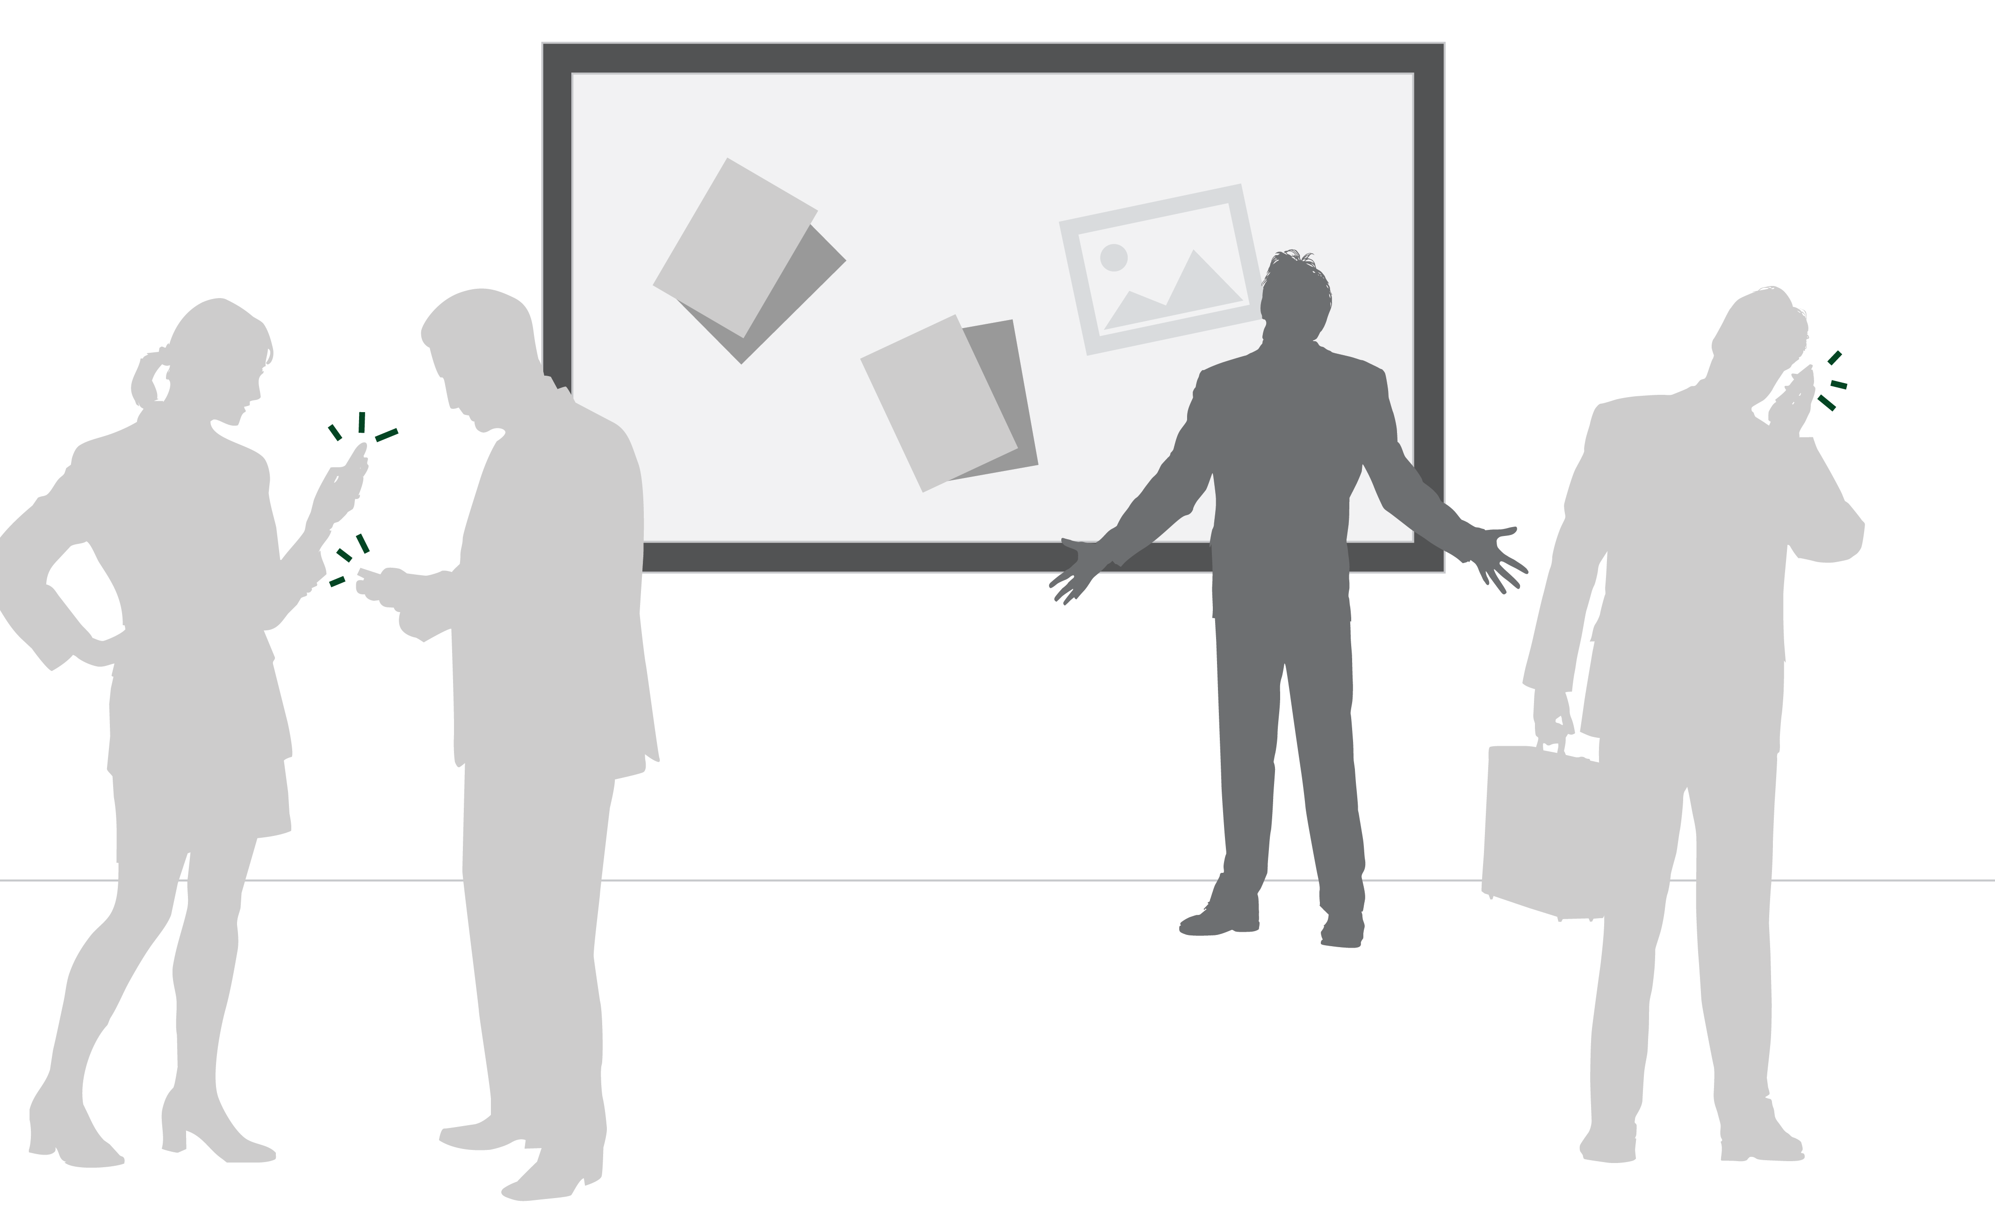
Personal devices are distracting
Notes:
When you walk into a room, you realize people are not engaged with each other because of their personal computer
Personal device vs Hub

Slide 28
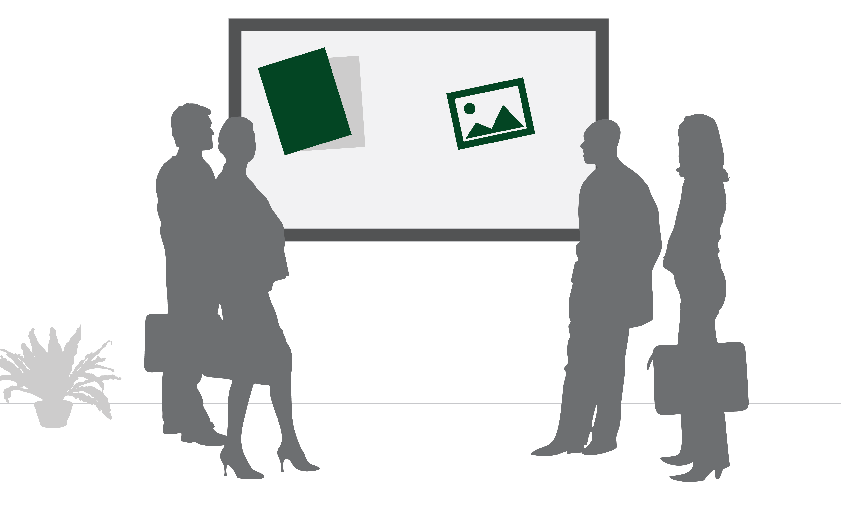
Shared screens create transparency of conversations
Notes:
Enable transparency not provide personal contents on the personal device
Sankar to jump in contrast with the current screen sharing and mention the transparency part of the conversation.

Slide 29
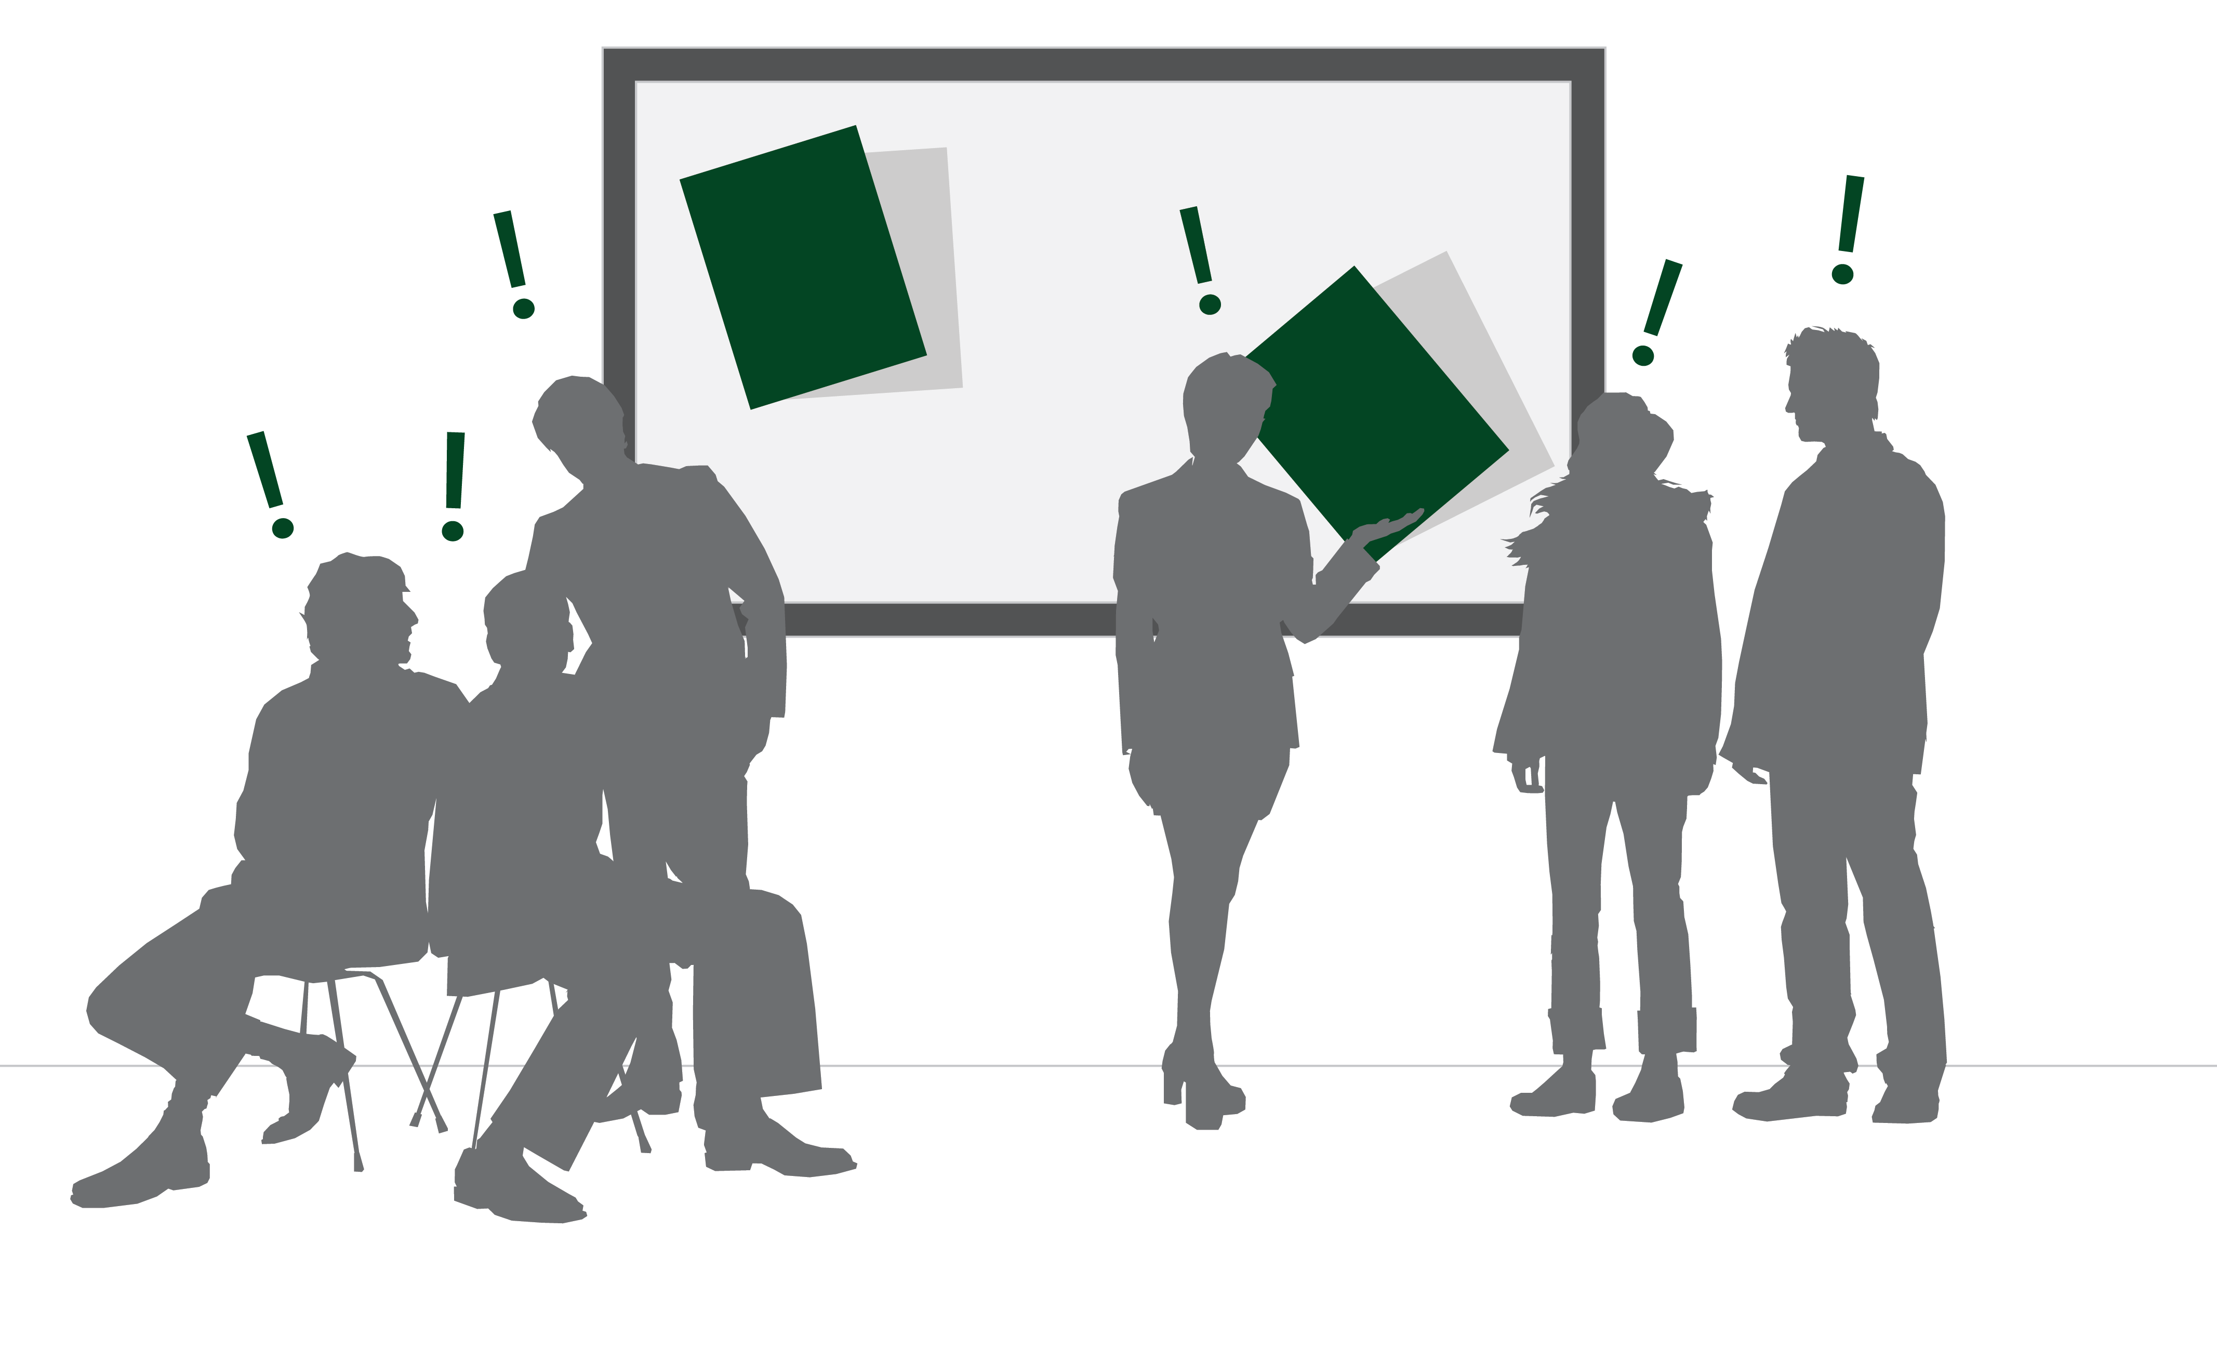
Conversations are enriched with digital content

Slide 30
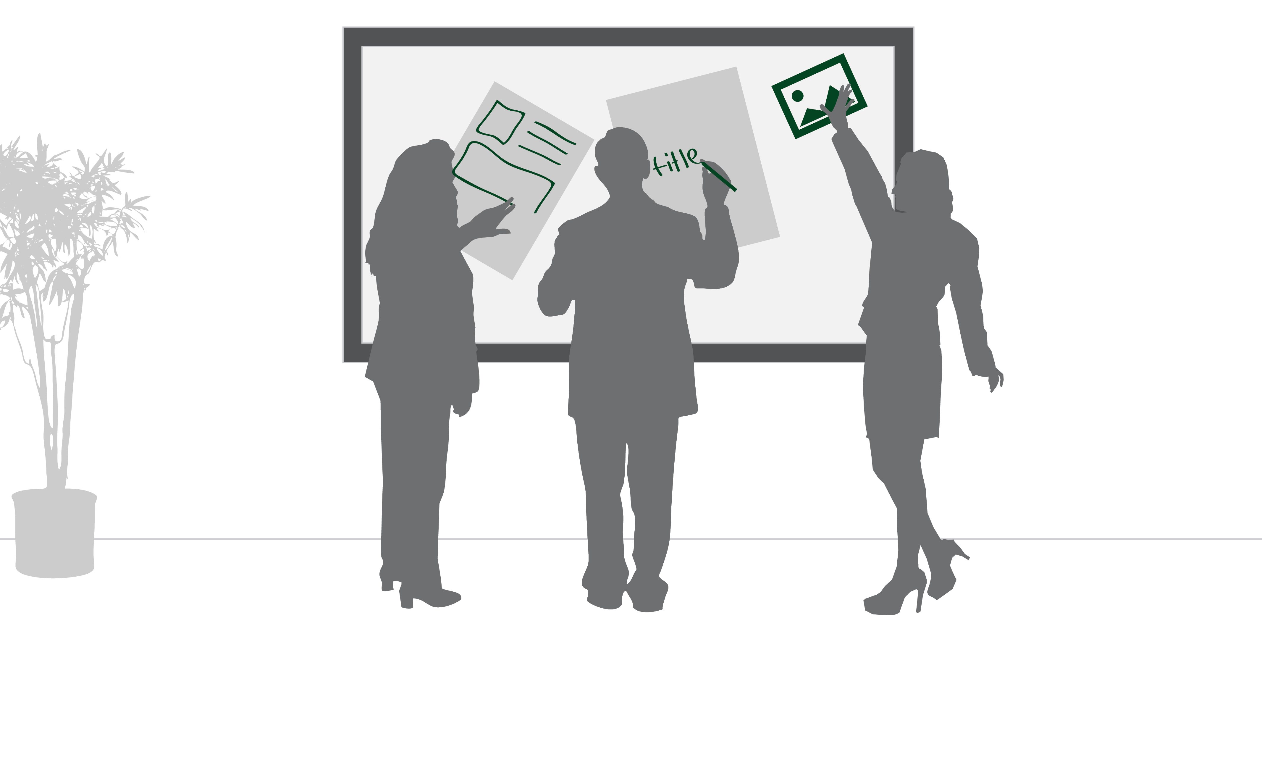
Meetings are more engaging

Slide 31
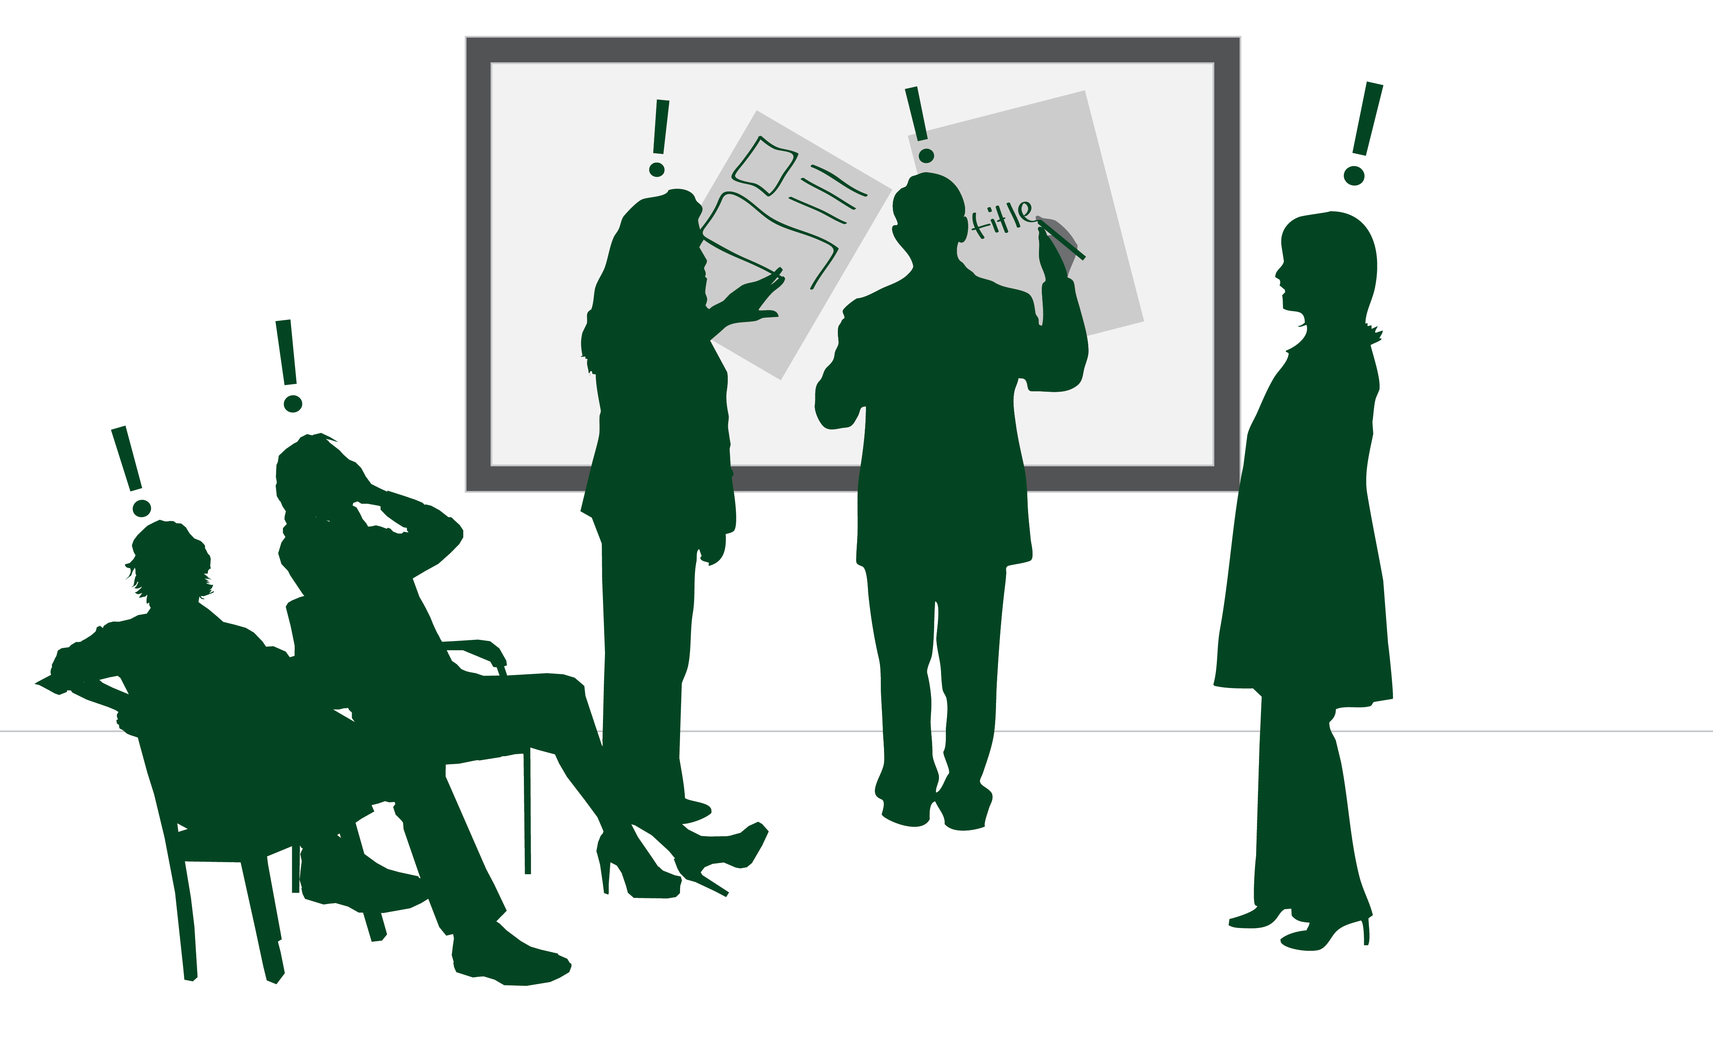
More people, more ideas, more focus
Notes:
Sankar to jump in and say: When developers bring all of these concepts together, they can unlock the real collaboration potential of this device and more importantly of the team they are looking to help with their apps.

Slide 32
The Surface HUB is Meeting Ready
Surface HUB is a device to enable richer meetings
Built in software to enhance meetings, third party software to enhance meetings (your job!)
It can receive input from multiple people at the same time
Touch, stylus, camera, NFC
Notes:
Sales pitch,

Slide 33
What you should think about

Slide 34

CLI > GUI > NUI

Slide 35
CLI > GUI > NUI
TEXT

Slide 36
CLI > GUI > NUI
TEXT
GRAPHICS

Slide 37
CLI > GUI > NUI
TEXT
GRAPHICS
OBJECTS

Slide 38
CLI > GUI > NUI
TEXT
GRAPHICS
OBJECTS
Recall
Recognition
Intuition

Slide 39
CLI > GUI > NUI
TEXT
GRAPHICS
OBJECTS
Recall
Recognition
Intuition
Directed
Exploratory
Contextual

Slide 40
CLI > GUI > NUI
TEXT
GRAPHICS
OBJECTS
Recall
Recognition
Intuition
Directed
Exploratory
Contextual
High-low
Double medium
Fast few

Slide 41
CLI > GUI > NUI
TEXT
GRAPHICS
OBJECTS
Recall
Recognition
Intuition
Directed
Exploratory
Contextual
High-low
Double medium
Fast few
Disconnected
Indirect
Unmediated

Slide 42
CLI > GUI > NUI
TEXT
GRAPHICS
OBJECTS
Recall
Recognition
Intuition
Directed
Exploratory
Contextual
High-low
Double medium
Fast few
Disconnected
Indirect
Unmediated
Static
Responsive
Evocative
Notes:
Dr. Neil to talk through the slide
Sankar to ask: So, Dr. Neil, is this brand new that we brought all of these things together?
Dr. Neil to talk about the history

Slide 43
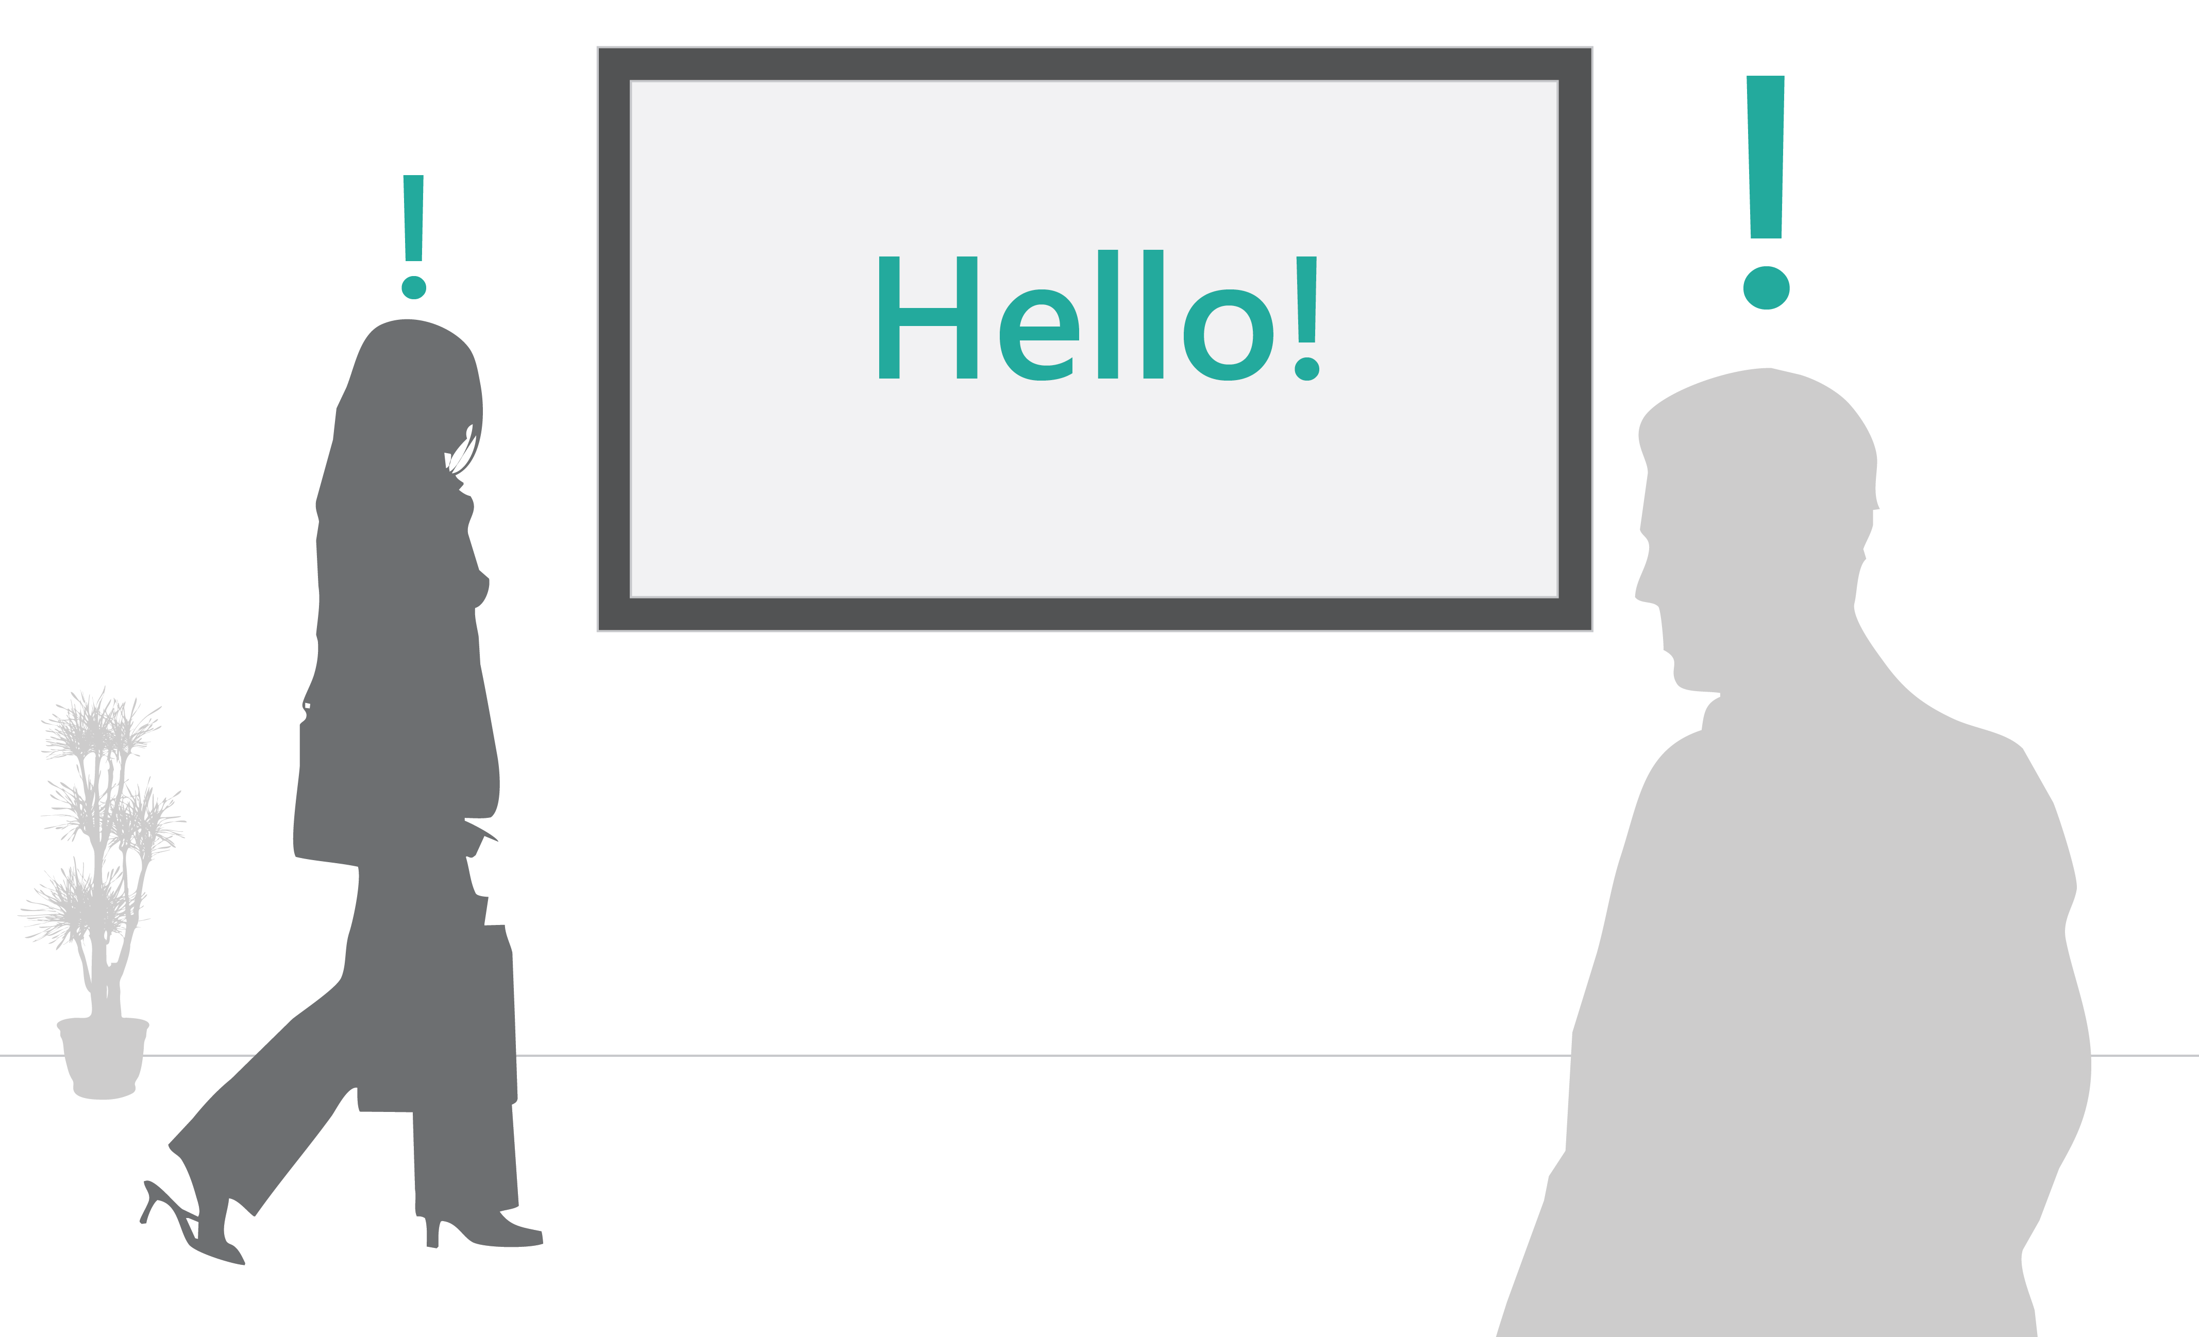
Engagement should be obvious
Notes:
Walk up and use

Slide 44
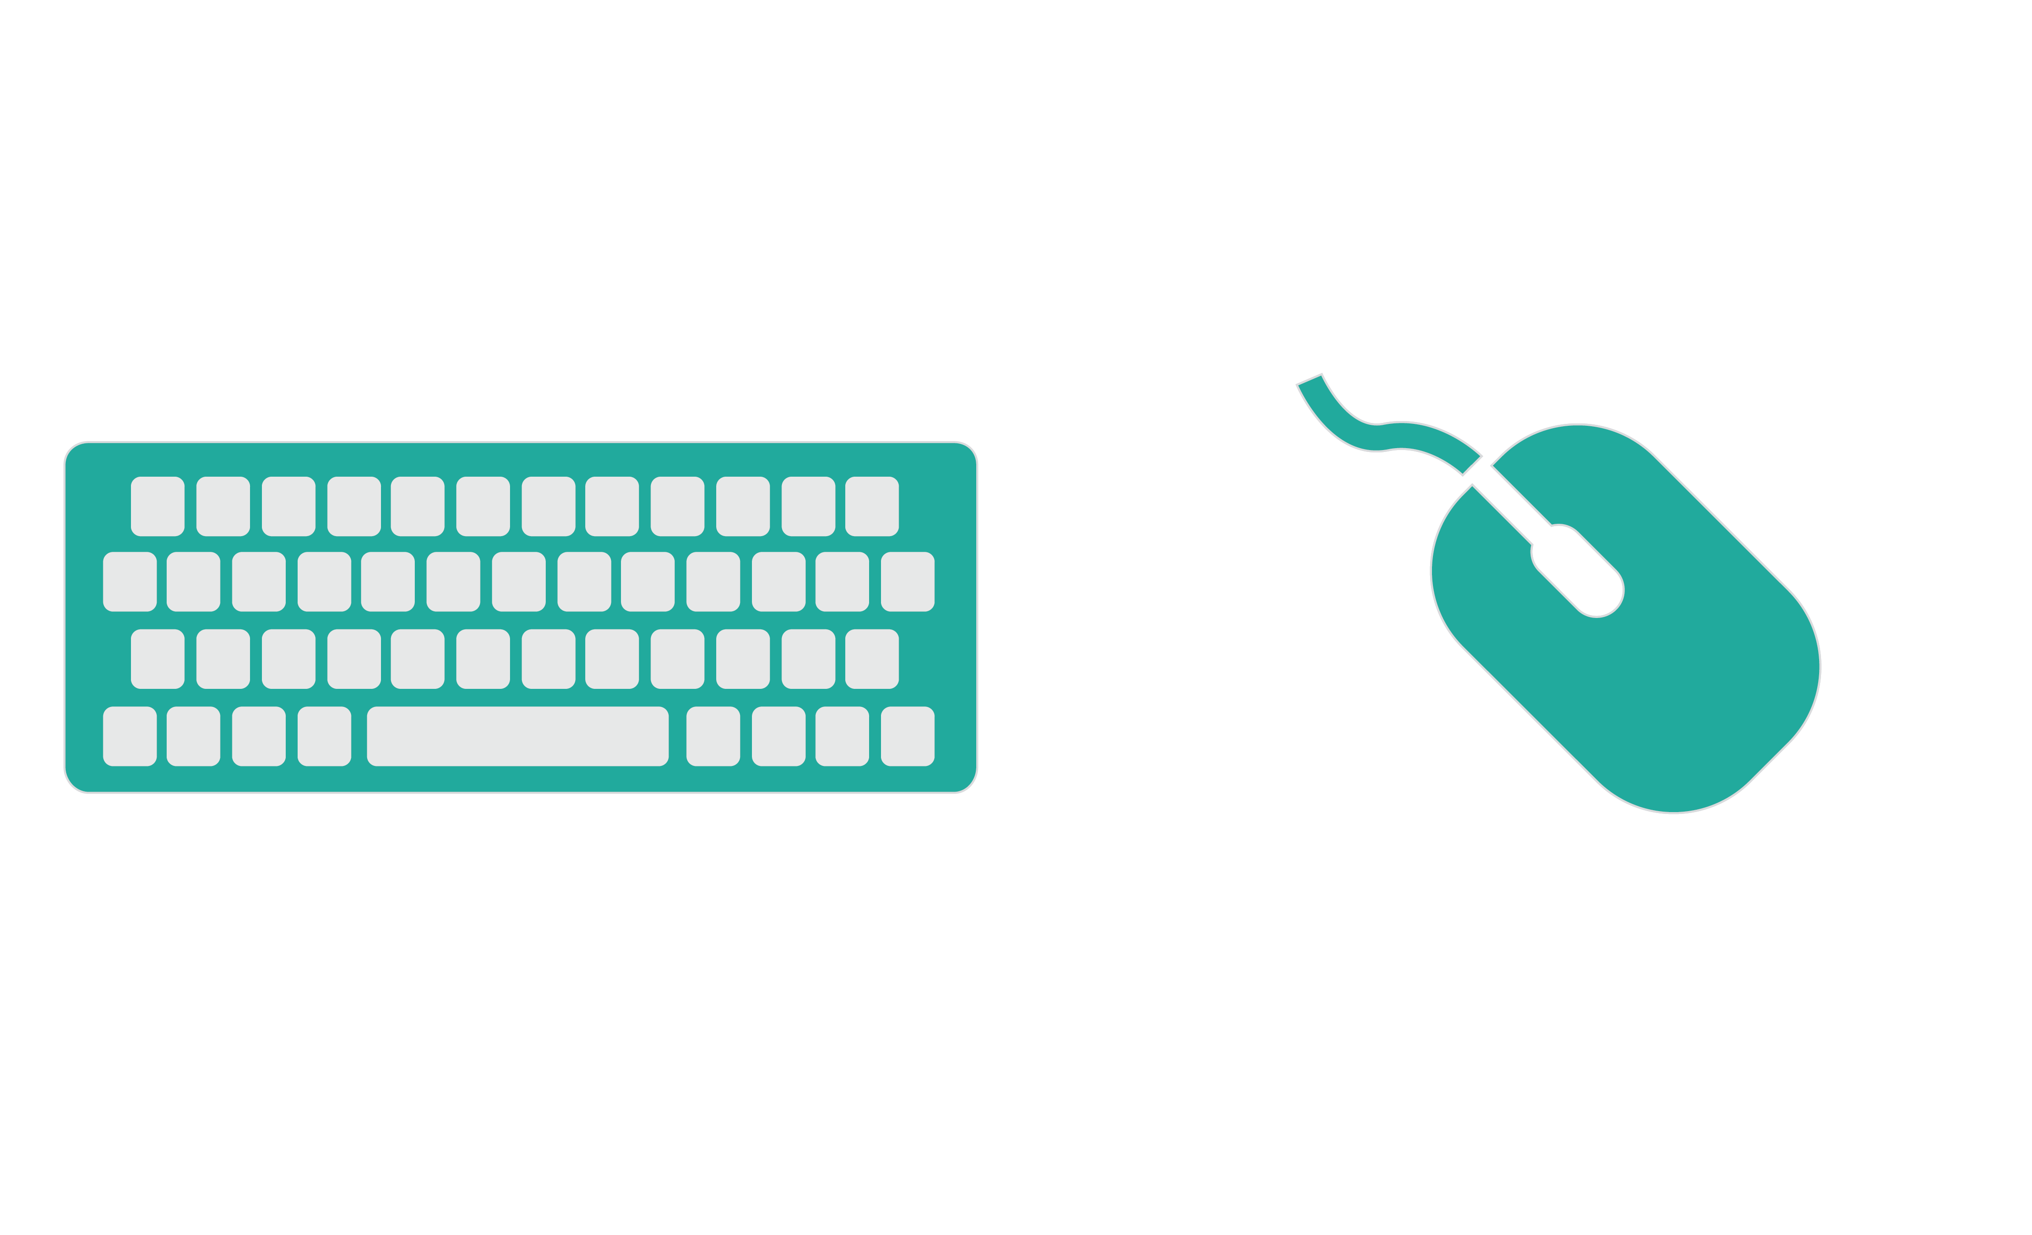
Interface is beyond keyboard and mouse

Slide 45
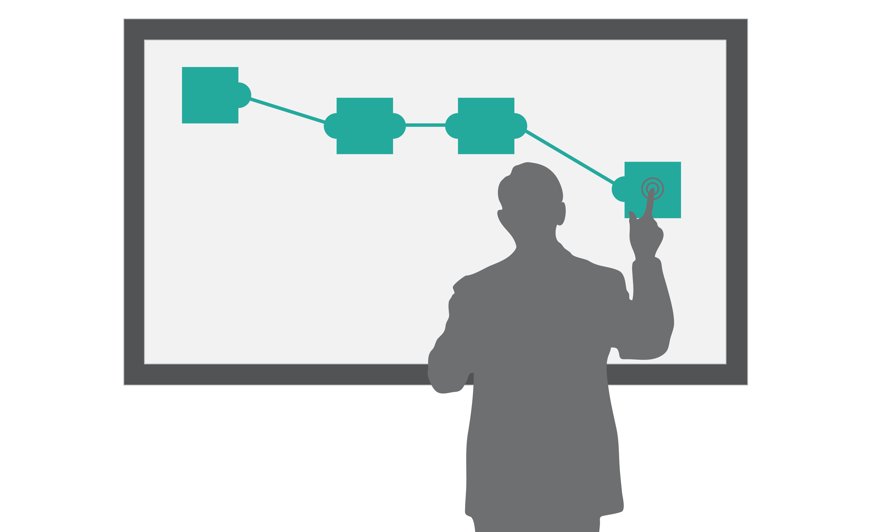
How do items on the screen relate to each other

Slide 46
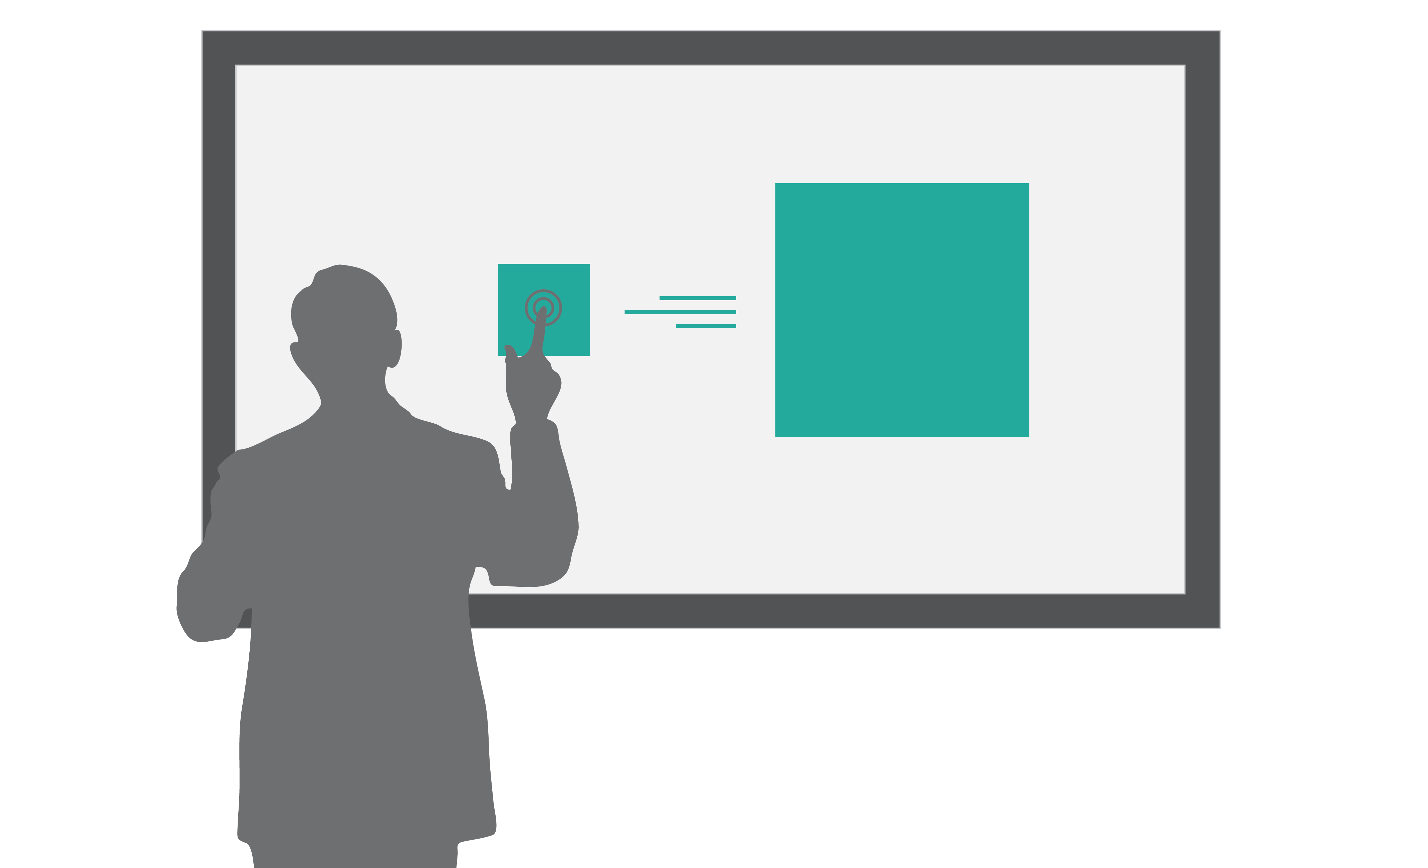
Clear transitions
Notes:
How do things get on the screen

Slide 47
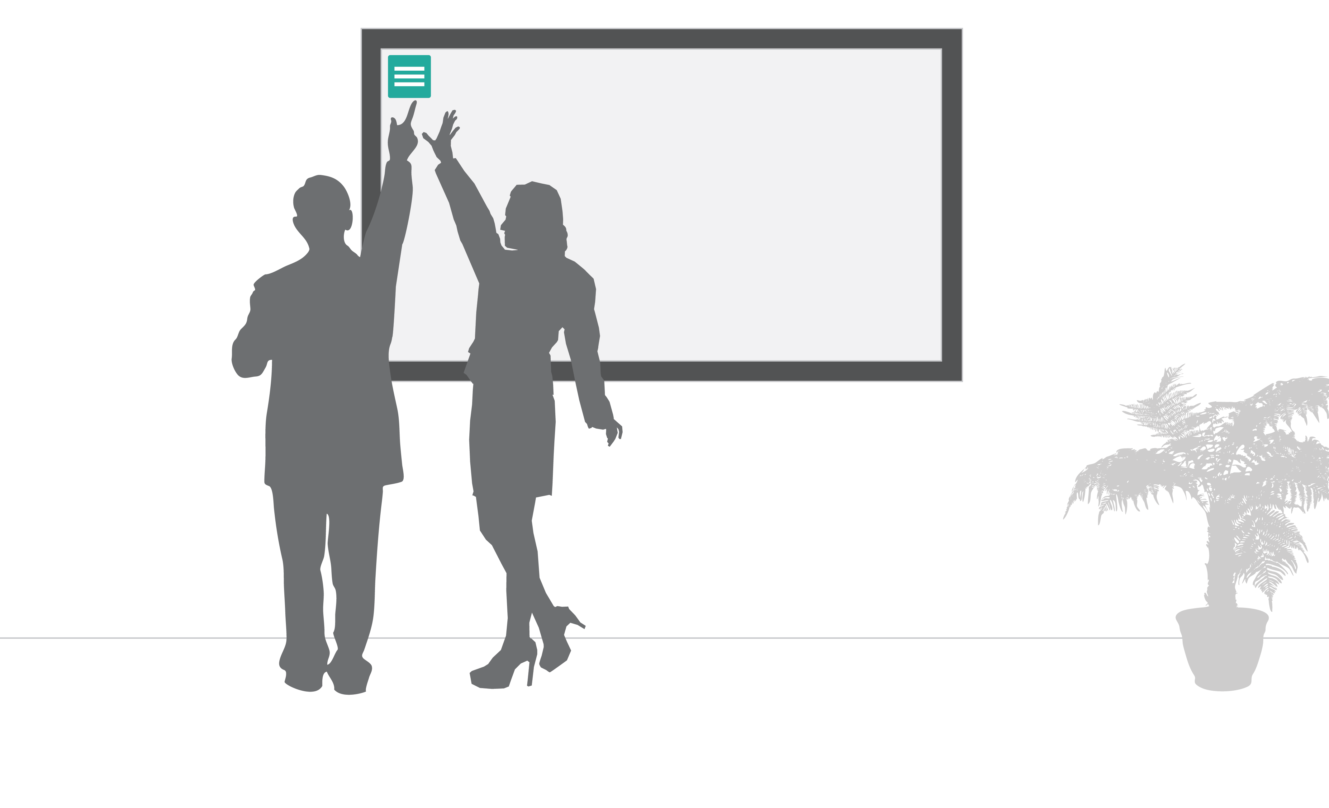
How do you use interface items and get to interface items

Slide 48

Spatial memory
Notes:
Menus should not move

Slide 49
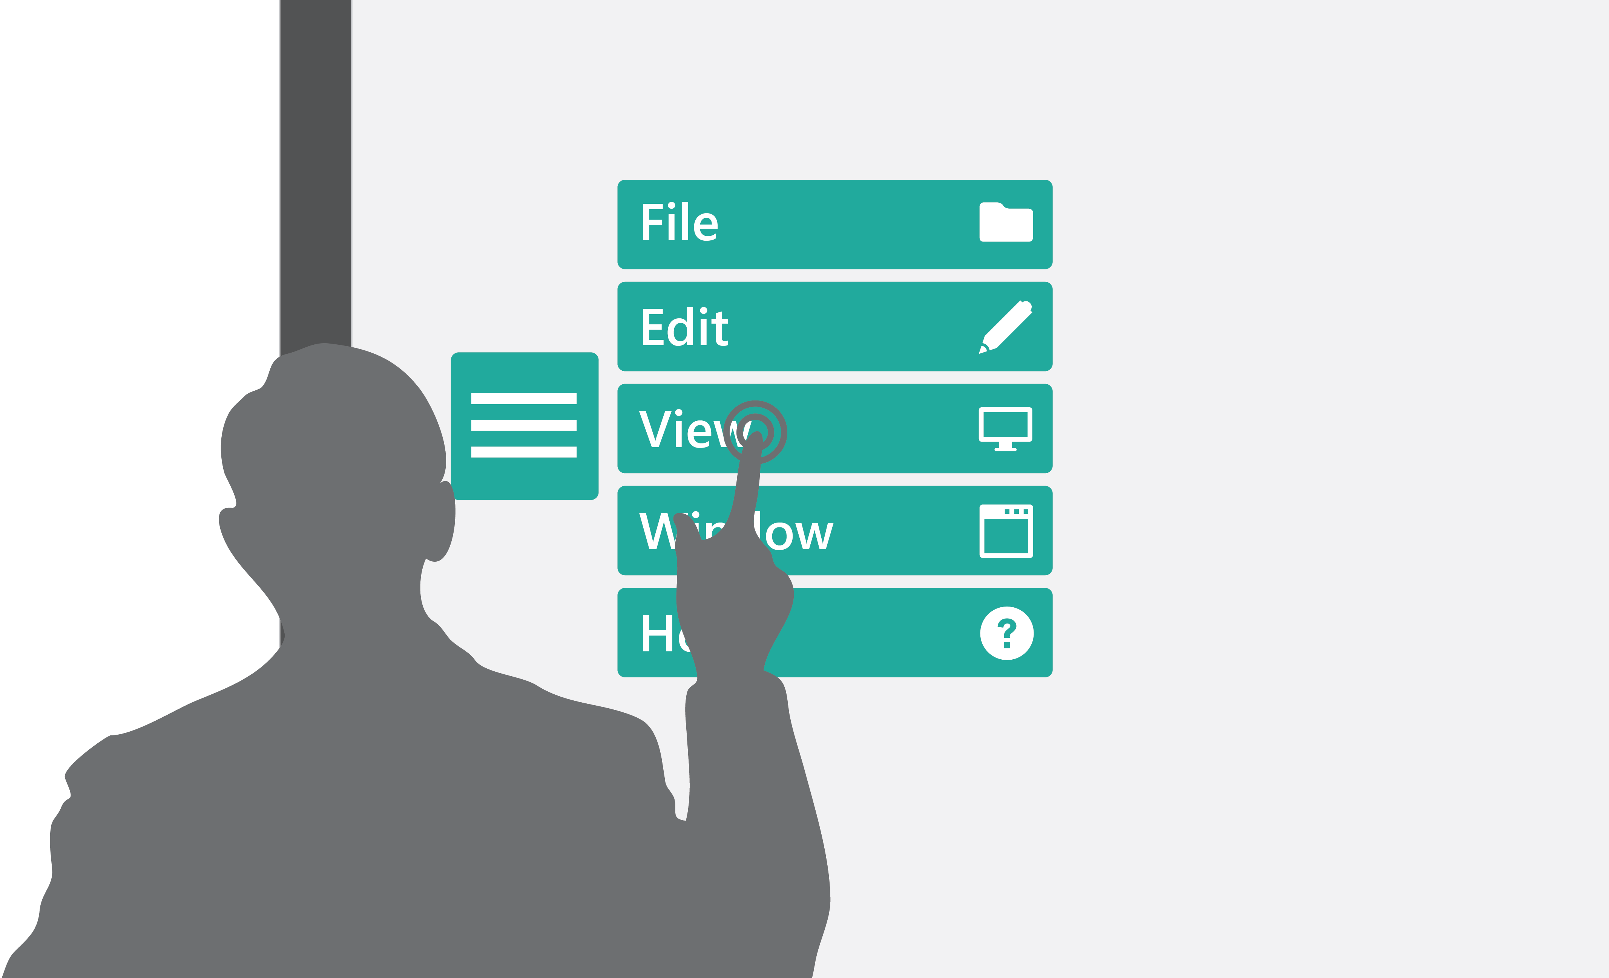
Consistency of UI
Notes:
Europe vs US cars

Slide 50

Mouse is more precise than finger, but GUI is single user

Slide 51
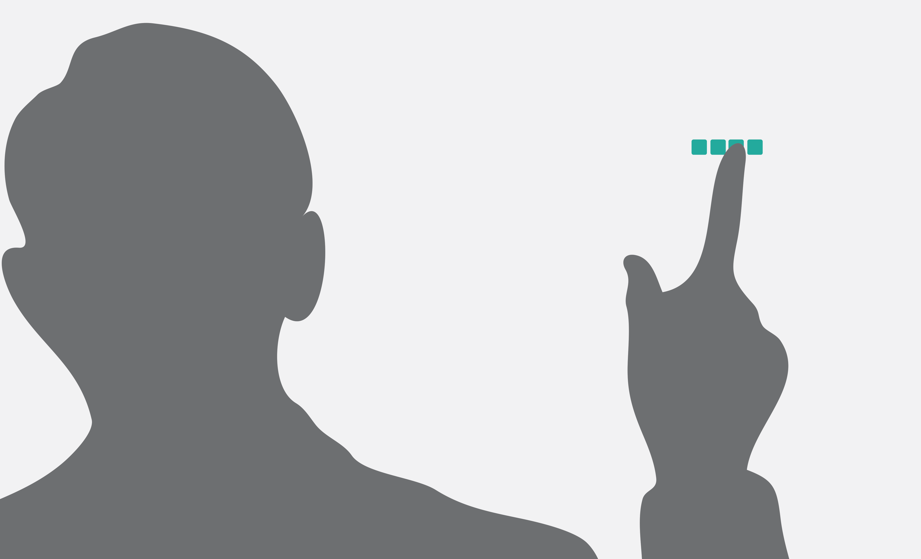
Icon sizes

Slide 52
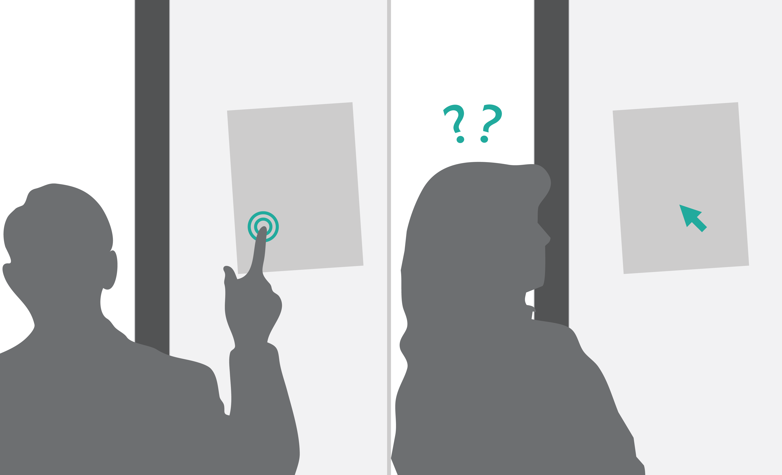
Direct manipulation – Indirect manipulation
Notes:
Direct manipulation - Touch is obvious
Indirect manipulation - Needs to be learned

Slide 53
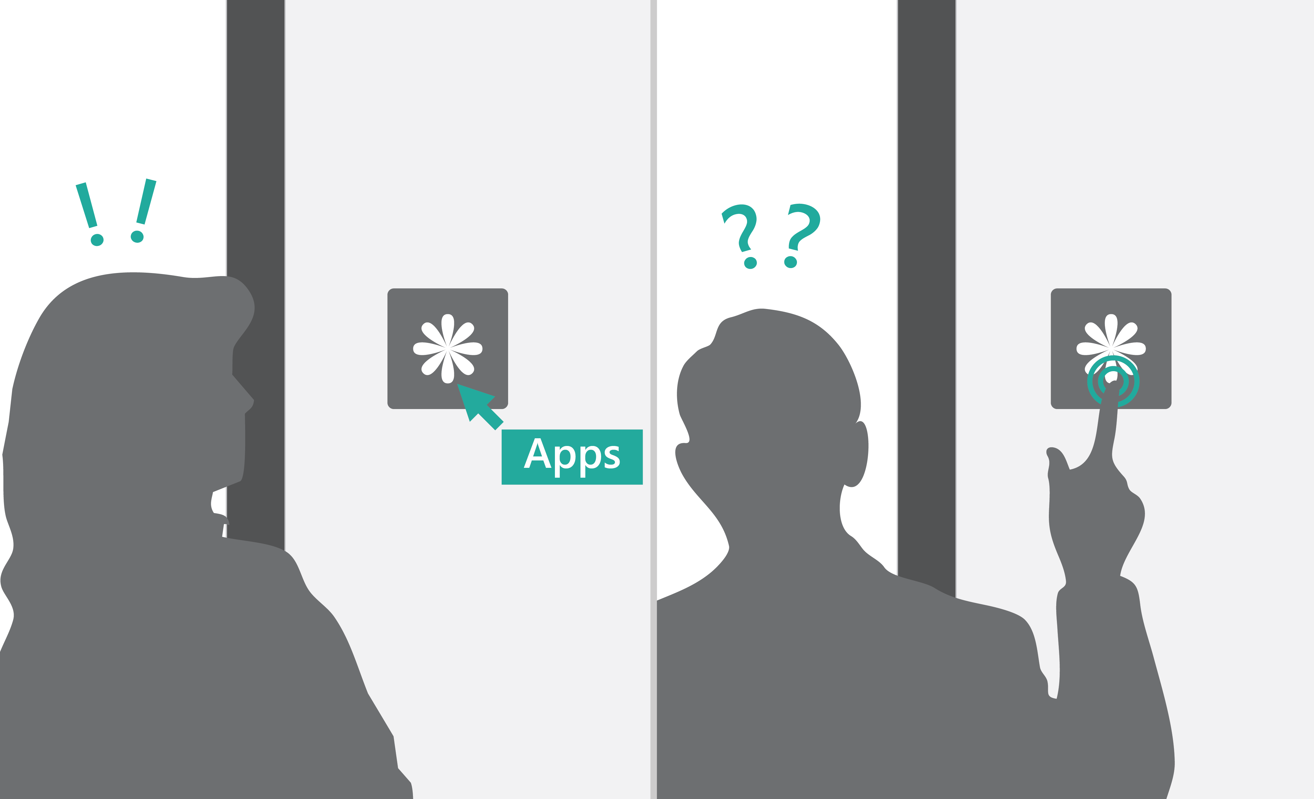
No hover
Notes:
Icons need to be obvious

Slide 54
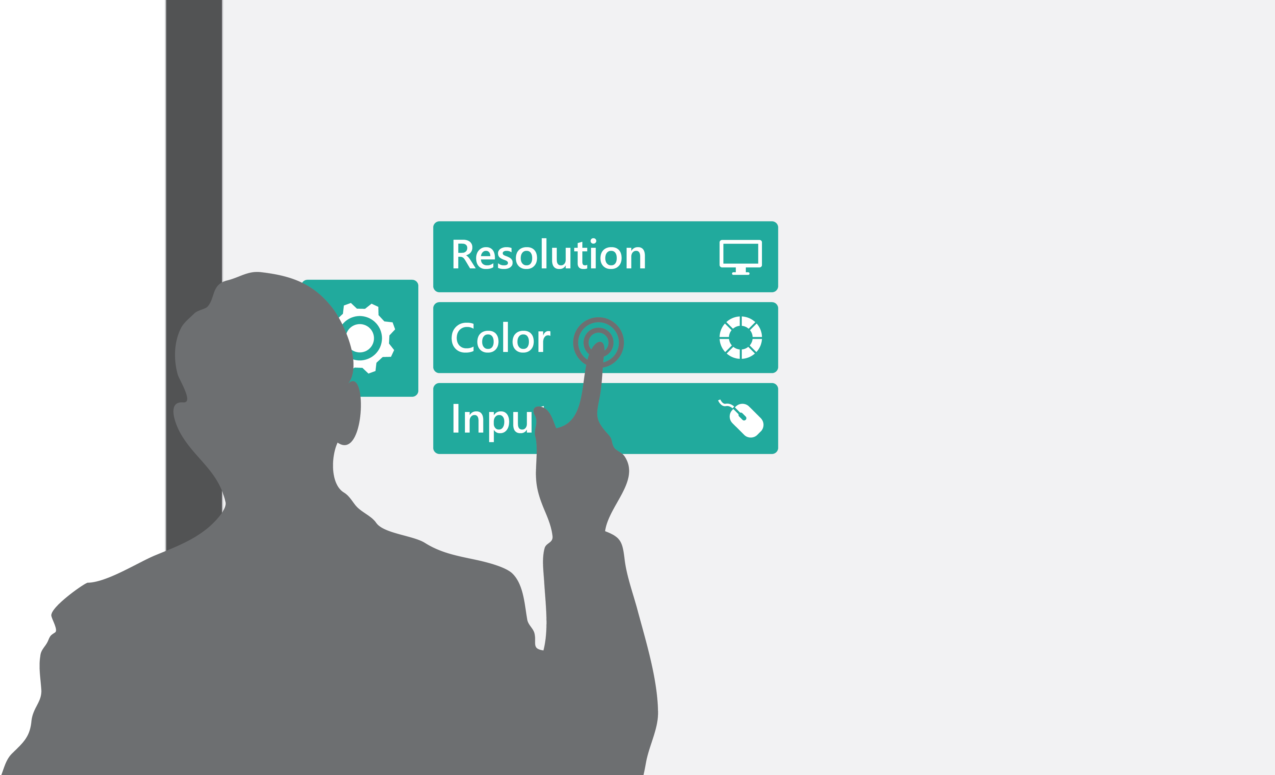
Menu system should be user friendly and touch friendly

Slide 55

Always provide feedback when touch occurs

Slide 56

Experience should improve when more people engage

Slide 57

Avoid modality
Notes:
Modal operations break other users experiences

Slide 58
Design Pillars
Social
Seamless
Spatial
Notes:
Dr. Neil will talk about the this session

Slide 59
Design Pillars
Social
Seamless
Spatial
Better with more people
Engages all
Emotive
Notes:
Dr. Neil will talk about the this session

Slide 60
Design Pillars
Social
Seamless
Spatial
Feels natural
Integrates with your environment
Walk up and use
Notes:
Dr. Neil will talk about the this session

Slide 61
Design Pillars
Social
Seamless
Spatial
Zoom and focus
Implied physicality of the space (It is a large screen!)
Leverage spatial memory
Notes:
Dr. Neil will talk about the this session

Slide 62
Surface HUB
Large shared screen
Collaborative
Engaging
Notes:
How the program coming together, UWP, what needs to learn before the Dr. Neil tutorials

Slide 63
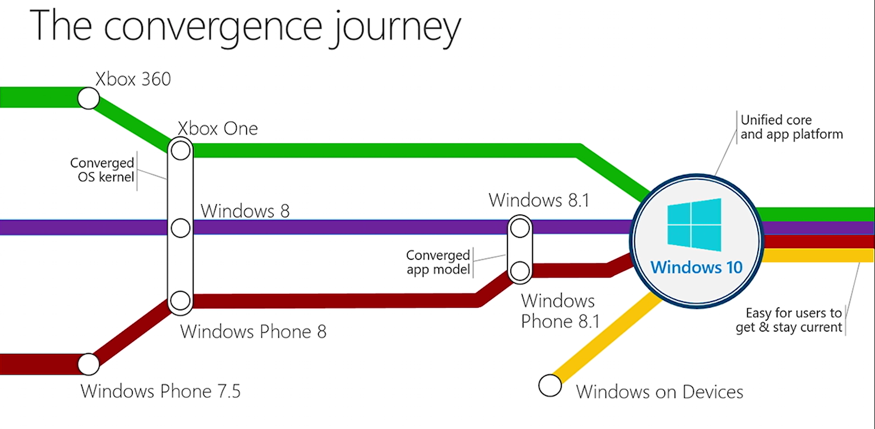

Slide 64
Journey to Windows 10
Windows PCs
Windows Phone
ONE CORE OS
ONE APP PLATFORM
ONE STORE
Windows 10
Xbox
Notes:
It has been a real journey for us to get to one Windows with Windows 10. Back in Windows 7 we started our journey to bring together Windows into one, scalable platform which could support the growing variety of devices and scenarios that developers wanted to build app experiences for. We started by merging the lower level parts of the OS, then the developer experience, and now with Windows 10, we have unified all of the Windows family.
At the same time, we have been able to quickly add several new device families to Windows. This has been a multiyear journey and with Windows 10 we now have one core operating system, one app platform, and one Store to empower developers to reach their Windows customers wherever they are and on whatever device they happen to be using.

Slide 65
Universal Windows Platform A unified Windows core and app model that supports how you develop your app
UI Framework
Desktop
Applications
(Win32, .NET, etc.)
Web
Applications
Services
Windows XAML
DirectX
HTML
Store
App model
Notifications
Navigation
Packaging
Mobile APIs
Xbox APIs
…
Desktop APIs
Roaming
Contracts
Universal App Platform APIs
Desktop Bridge
Hosted Web Apps
Credentials
Background
Windows Core
Notes:
UWP provides common APIs that can be used across all different devices powered by Windows 10. Alongside these common APIs, there are extensions available for each of the platforms that offer distinct capabilities (such as Mobile, Xbox and Desktop). These extension APIs work with the API contracts functionality to enable developers to light up features on devices that have these capabilities, but ensure the core of the app works across all devices. UWP also provides a number of UI frameworks, such as Windows XAML, DirectX and HTML to act as the user interface layer of the apps.
Beneath the APIs, UWP also provides an app model that looks after the complete lifecycle of the apps, from installation to uninstallation, providing a cleaner way for apps to be installed, run, updated and uninstalled, preventing “Windows rot”. The app lifecycle also provides limited background execution of apps (only one foreground app executes at a time, with mechanisms in the OS to ask for specific background task execution (on a schedule, triggered by various events (e.g. Internet/Bluetooth connectivity, power changes, etc.) and in specific scenarios such as music playing or GPS tracking).
The third part of UWP is the unification of the services, providing a single distribution and monetization mechanism through the Windows Store. The notification model has also been unified, enabling developers to send notifications in a single format to the various Windows devices. A light-weight model to roam data across devices is also provided to reduce complexity in providing settings and small amounts of data across devices.
<click>
Finally, we haven’t forgotten about existing developers who have invested in building applications on Windows and other platforms. Let’s take a closer look.

Slide 66
Other Resources
Get to know Windows 10 UWP
https://channel9.msdn.com/Events/Windows/Developers-Guide-to-Windows-10-RTM
Surface Hub Design Overview
Surface Hub App Development Tutorial
Questions?
Email: hellouwp@Microsoft.com
Channel9 Forums
Notes:
How the program coming together, UWP, what needs to learn before the Dr. Neil tutorials

Slide 67
Thank you

